Slide 1
IPv6 Deployment
in China
Jessica Shen
@ APNIC 40

Slide 2
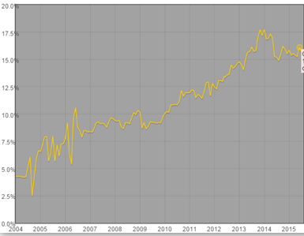
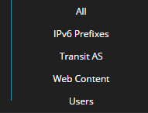



IPv6 Measurement on China by Others
IPv6 enabled network:
16.12% ASes announced
IPv6 prefixes

Slide 3
IPv6 deployment Overview
Network
Policy
Environment
User End
Content

Slide 4
Policy Environment
Government policies on promoting IPv6
CNGI project during 2013-2015
- Backbone network and MAN
- Data center
- Website
- Application System
- CDN
- DNS
- Equipment
Nov. 2014 Chinese government issued "Opinions on Promoting the Deployment and Application of IPV6 in LTE.“, to accelerate the commercial use of IPv6 on the mobile Internet, by ensuring new LTE networks support IPv6, ensuring VoLTE adopts IPV6, and accelerating IPV6 adoption for mobile applications

Slide 5
Commercial Network — 3 Tier one carriers
Backbone network ,MAN and access network can largely support IPv6, most network equipments can support IPv6
LTE network can support IPv6 by default
Dual-stack is the dominant mode
IPv6 capable users are around 30 million, but less actual IPv6 users
Set Dual-stack as the default for new access users, in some pilot cities
Keep working on reform and upgrade of Data center , O&M system, AAA system and DNS

Slide 6
Commercial Network
Backbone | Backbone 163 fully support IPv6
 | CN2 B supports IPv6 by 6VPE
MAN | Up to 180 MAN deployed dual-stack，58%
 | Over 3315 BRAS/MSE equipments supportIPv6
IDC | 159 IDC with Dual-stack，49%
 | 4-star and above IDC fully supportIPv6 access
LTE network | LTE support IPV4/IPV6 dual stack by default
User | LTE dual-stack users reach 2.4 million
CHINANET

Slide 7
Commercial Network — ISP
Founder BroadBand Network
Requested a /32 from CNNIC
Provide IPv4/IPv6 dual-stack access service
in Two cities (Beijing and Tianjin)
PPPoE users, with home gateway
BRAS sets 2 address pools, and gives 2 /64s to a home
gateway, one for interconnection, another for further
assignments to devices in the home

Slide 8
Content — Large content providers
Tencent and Baidu
Fast deployment allowing IPv6 users to visit large amount of IPv4 content
Dual-stack
NAT66 + Reverse Proxy
Websites with IPv6 and traffic
ipv6.baidu.com PV：300M
pan.baidu.cn
qq.com PV：600M
qzone.qq.com
t.qq.com
Application design
Avoid hard-coded IP addresses
Expertise team on IPv6

Slide 9
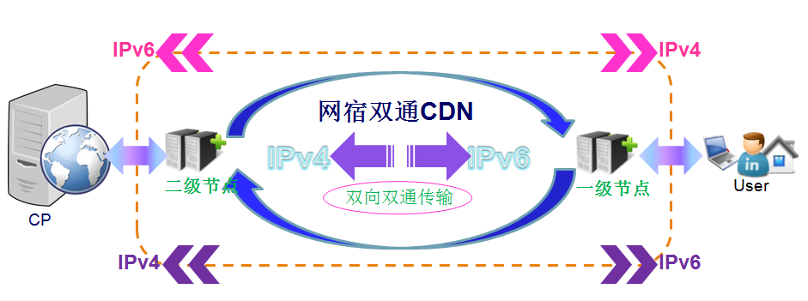
Content — CDN
ChinaNetCenter’s CDN Platform
Support IPv6, regardless of CP’s origin & end user, with either IPv4 or IPv6
Services cover IPv4-IPv4, IPv6-IPv6, IPv4-IPv6 and
IPv6-IPv4
Solve the user IP addr. lost problems brought by Carrier level transaction solutions

Slide 10
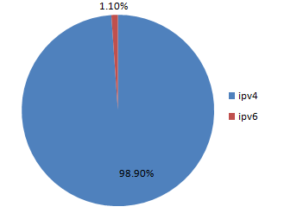
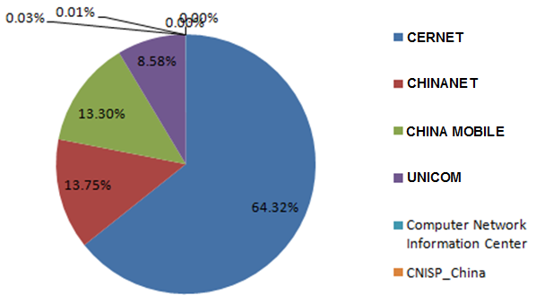
Content — CDN
Seen from ChinaNetCenter’s IPv6 traffic
IPv6 Traffic from different networks
Win10’s download traffic

Slide 11
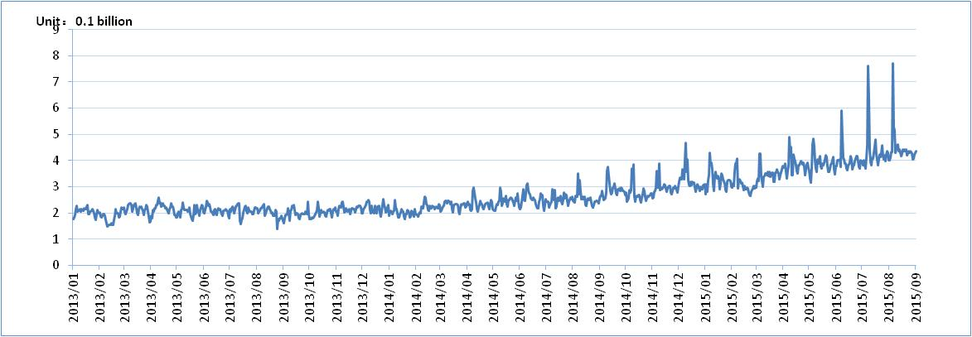
Content — Seen from DNS
. CN & .中国 (CNNIC)
18 global DNS nodes, 5 of them support dual-stack:
Chicago , Dallas, Amsterdam, Beijing and Hong Kong
Top-level domain fully supports IPv6 by dual-stack
mode, . CN IPv6 recursive queries (AAAA record)
ratio is 8.12%

Slide 12

User End
Smart User end devices, like home gateway, cell phone, tablet, laptop, network printer, storage, haven’t well support IPv6 on the whole;
The terminal chip with LTE mode performs better support to IPv6
Dual-stack , IPv6-only

Slide 13
Thank you!
Jessica Shen
<shenzhi@cnnic.cn>

