Slide 1
IANA Department Update
APNIC 33, New Delhi
29 February 2012
Elise Gerich
VP IANA
ICANN

Slide 2
Overview
Continuous improvement
Other Services
Statistics & more

Slide 3
Continuous Improvement

Slide 4
Business Excellence
3rd annual EFQM self-assessment held in January 2012
  Significant improvements for our customers in processes and key results
  Next steps: continue measures for KPIs & identify additional areas for improvement

Slide 5
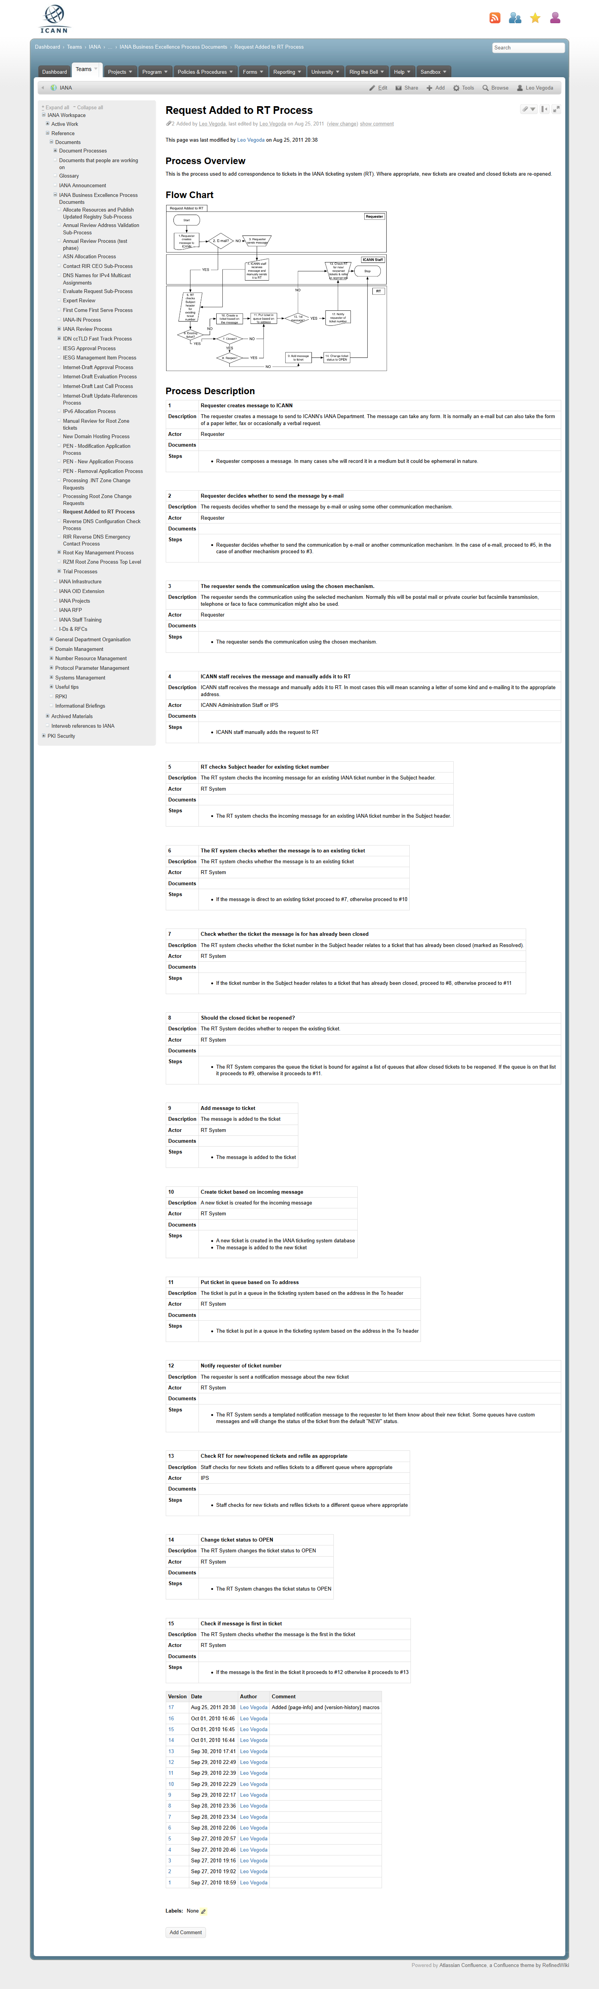
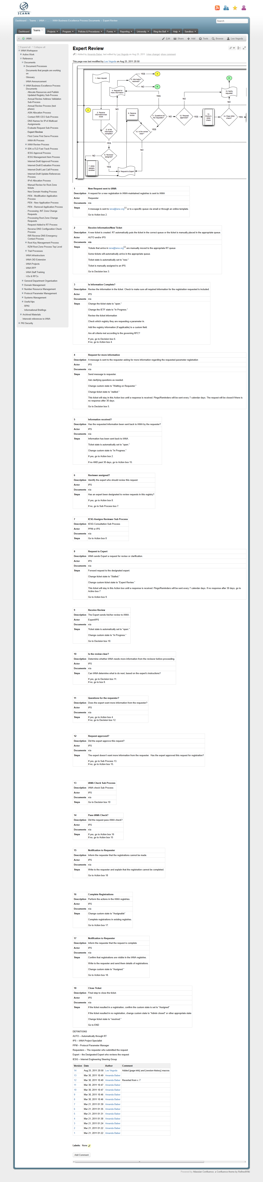
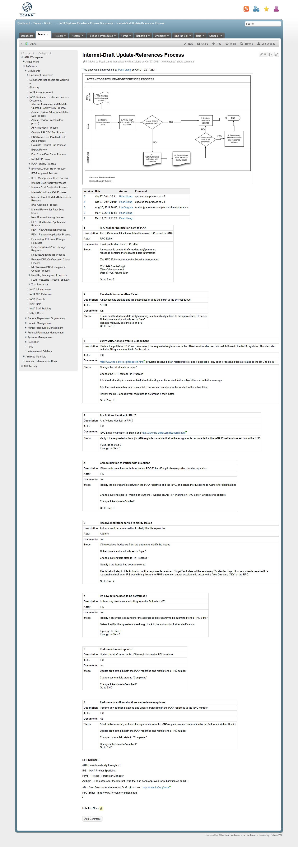
Standard process documentation
We have converted over half our core processes to a standardized format and will be converting more in 2012

Slide 6

Customer survey
We will be running a customer survey to gather structured feedback we can use to improve our services

Slide 7
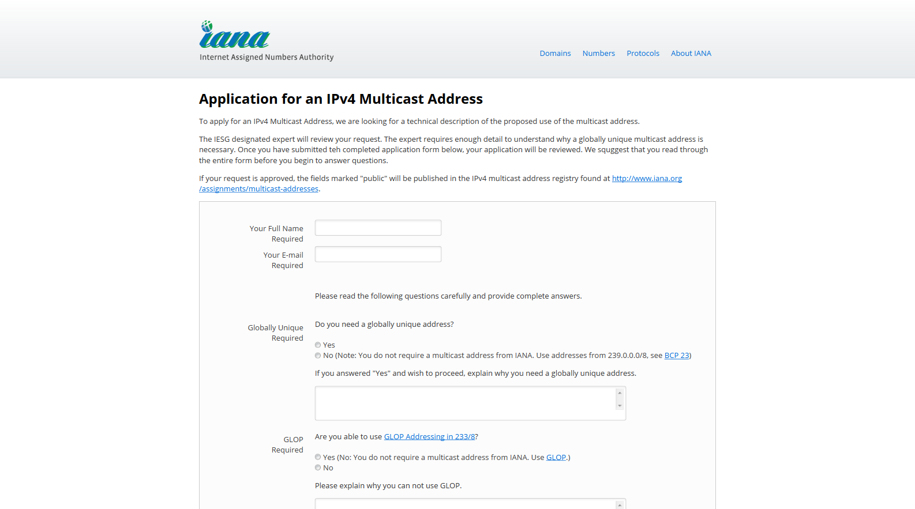
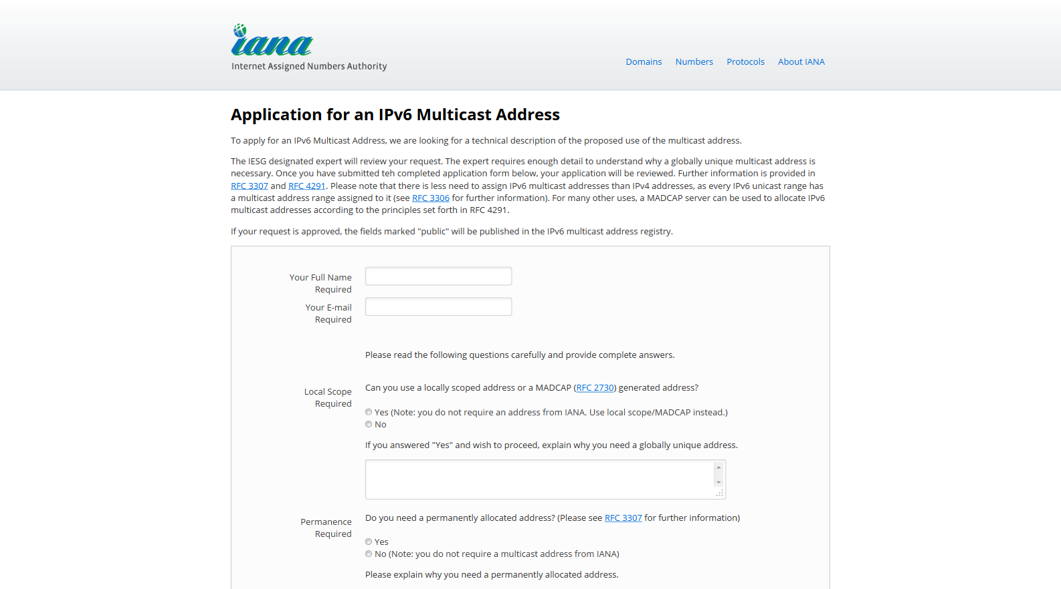
Improving our request processes

Slide 8

Security & continuity
4th annual security plan revised in November 2011
2nd IANA continuity exercise is planned for 2012, building on the success of 2010
CC BY 2.0 license from
flickr.com/dylancantwell

Slide 9
Key Ceremonies since APNIC 32
Ceremonies 7 & 8 were successfully completed
Full transcripts & logs are published on the dns.icann.org web site

Slide 10
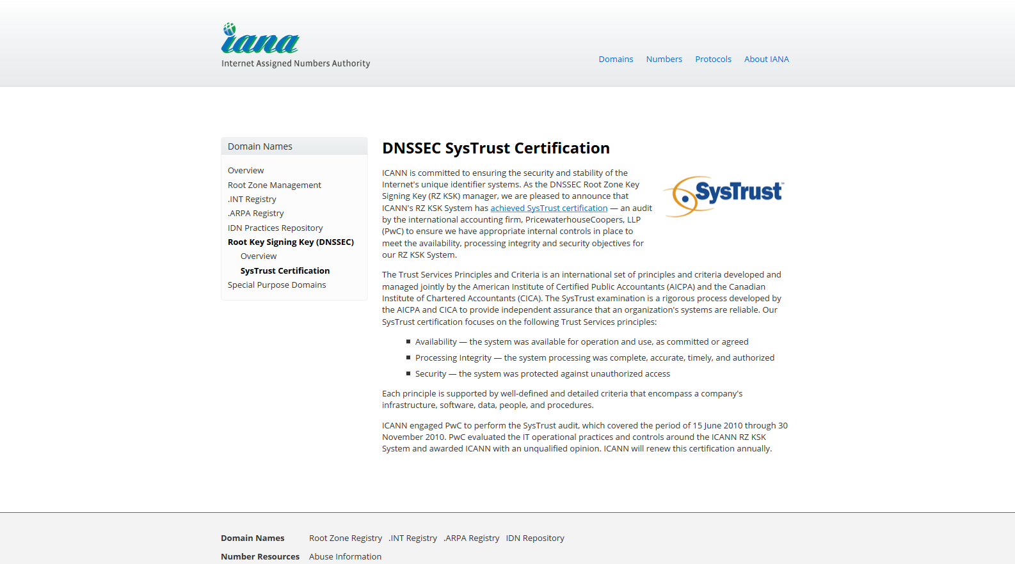
SysTrust certification renewed

Slide 11
Other ICANN activities…

Slide 12
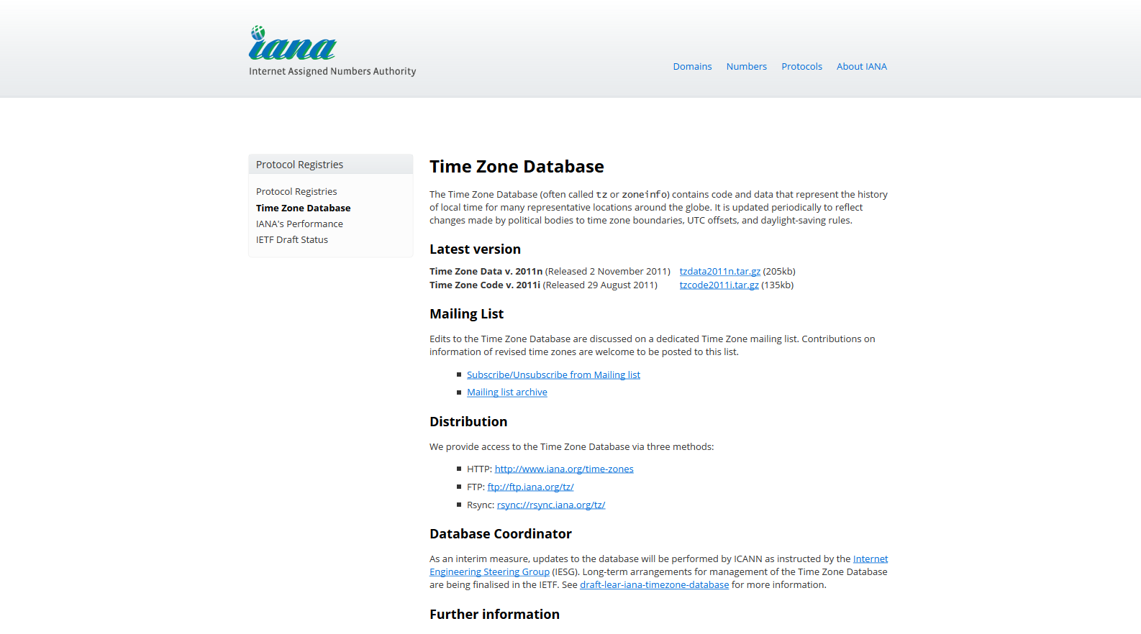
Time Zone Database

Slide 13

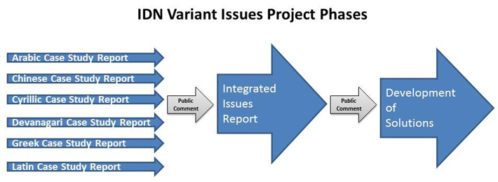
IDN Variant Issues Project Phases

Slide 14
IDN Variant Issues Project Info
Community wiki
  https://community.icann.org/display/VIP/Home
Public discussion list vip@icann.org
  https://mm.icann.org/mailman/listinfo/vip

Slide 15
Statistics

Slide 16
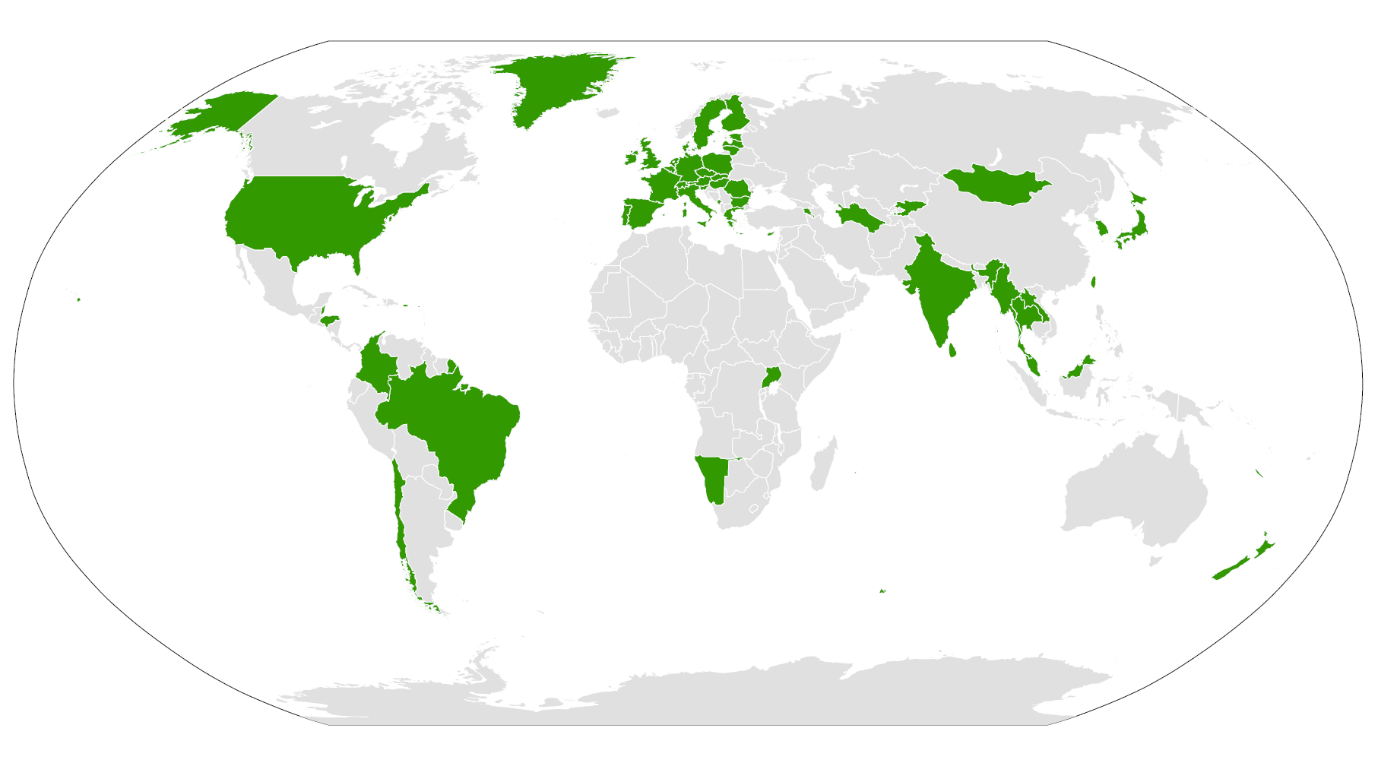
ccTLD DNSSEC map – Jan 2012
http://www.icann.org/en/topics/dnssec/deploy-en.htm

Slide 17
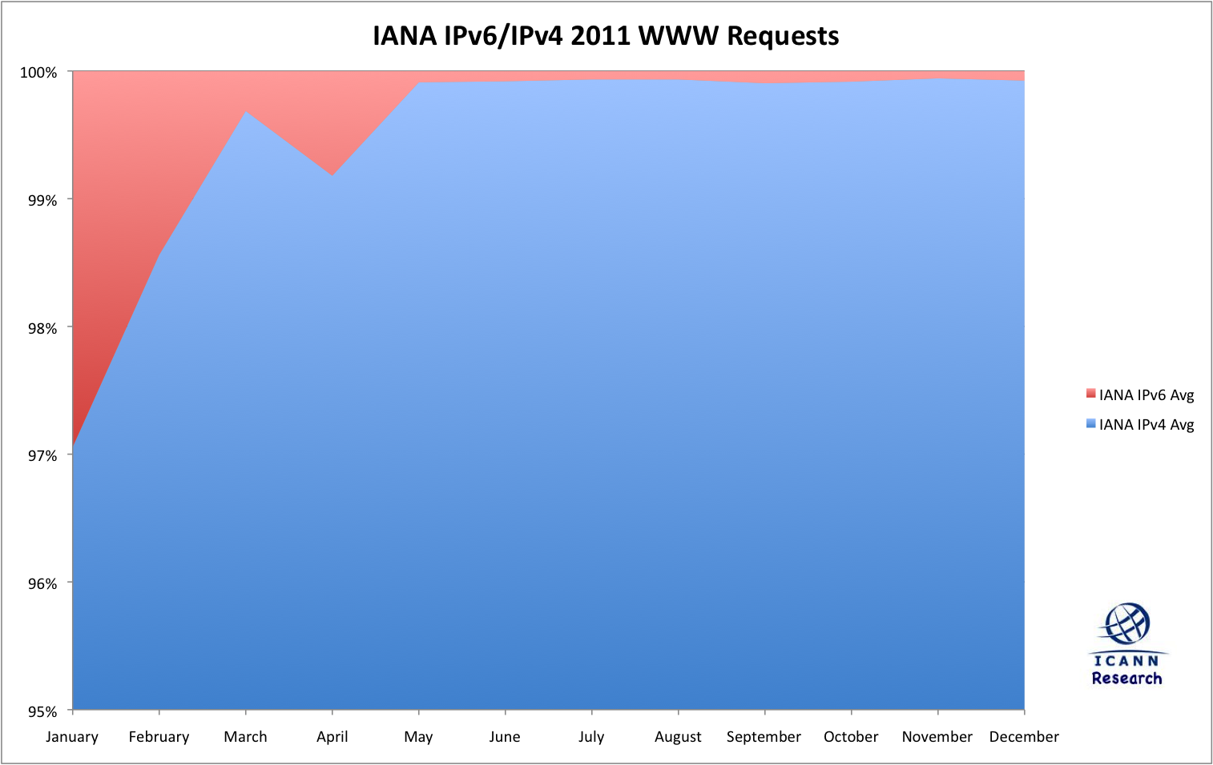
IPv6 web stats

Slide 18
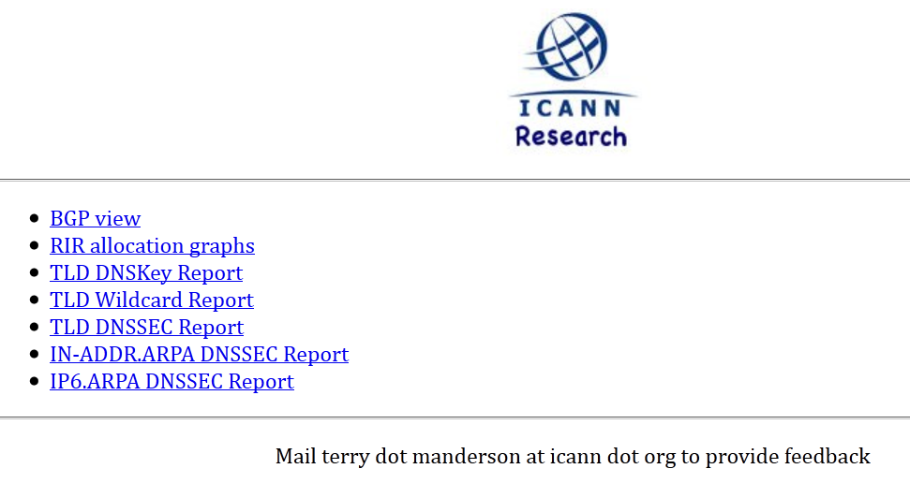
But wait, there’s more!
Too much to report here
Check out our research web site for a series of daily reports on the health of Internet resources
http://stats.research.icann.org

Slide 19
Thank You

Slide 20
Questions

