Slide 1
Services Area Report
Sanjaya Services Area Director

Slide 2
Key Deliverables
Delivering Value
Resource delegation
Resource Quality Assurance
Member services
Supporting Internet Development
DNSSEC
Root Server deployment

Slide 3
Delivering Value

Slide 4
IPv4 Exhaustion
Now in Stage 3 as of 15 April 2011
APNIC’s last /8 block is 103.0.0.0/8
Each account holder may receive a maximum of a /22 from APNIC’s last /8 space
From 15 April to 27 August 2011, made 583 delegations to 30 different economies

Slide 5
IPv4 Exhaustion
Returned IPv4 addresses will be redistributed under the last /8 policy
IPv4 addresses will be available in limited quantities for a long time
http://www.apnic.net/ipv4-stage3-faq

Slide 6
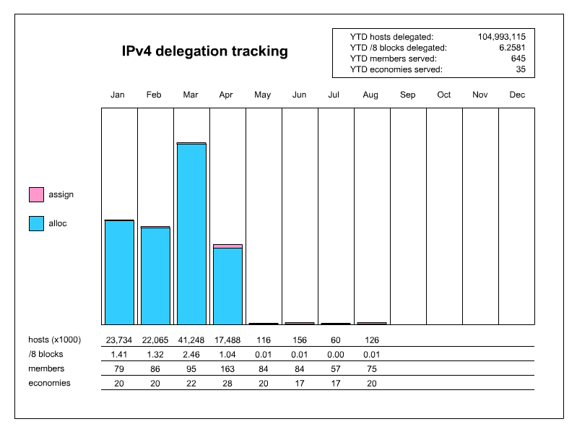
IPv4 Delegations 2011
As of 26 August 2011

Slide 7
IPv6 Delegations
Continued strong growth in IPv6

Slide 8
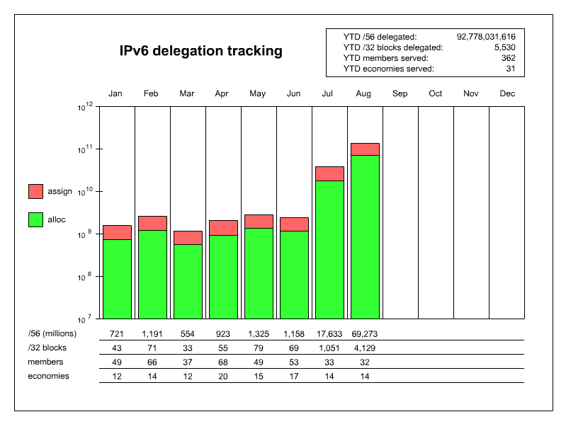
IPv6 Delegations 2011
As of 26 August 2011

Slide 9
AS Number Delegations
Steady growth of AS delegations
4-byte ASN
NIR allocations
(6 NIRs @ 100)

Slide 10
Resource Quality Assurance
Minimizing routability problems
Reachability testing designed by R&D to identify problems with blocks
Quarantined blocks retested every three months
Responsibly filtering – keeping ACLs and filters updated

Slide 11
Network Abuse BoF
Held on Monday, 29 August 18:00 – 19:30
Topic: Sharing information on activities to address concerns about Internet Resource Management and Quality Assurance of IP addresses with an emphasis on Network Abuse
Great turn out with 47 people attending
Speakers in order of presentation:
Izumi Okutani, JPNIC
Elise Gerich, IANA
Sofia Silva, LACNIC
Frank Salanitri, APNIC
Sanjaya, APNIC, on behalf of ID-CERT
Paul Vixie & Peter Losher, ISC
http://meetings.apnic.net/32/program/bof

Slide 12
Member Services
 | 2011
SUPPORT | Q1 | Q2
E-mail | 4,171 | 2,661
Phone | 571 | 510
Chat | 523 | 429
New Members | 129 | 163
Mergers & Trf. | 13 | 20

Slide 13
DNSSEC
Domain Name Security Extensions
3 May 2011 DNSSEC Delegation Signer (DS) records submitted to IANA allowing DNSSEC validation to occur from root zones down to APNIC’s reverse zones
Users can now update their reverse DNS DS record through MyAPNIC
Single zone updates via Whois domain objects
Multiple zones updates via zone file upload

Slide 14
Root Server Deployment
Bhutan
Operator: I-root
Local host: Bhutan Telecom
Location: Thimphu
Status: Inaugurated 14 April 2011
Mongolia
Operator: F-root
Local host: ICTPA & Mobinet
Location: Ulaanbaatar
Status: Shipped, target operational September 2011

Slide 15
Thank You

