Slide 1
Communications Area Report
German Valdez
Communications Area Director

Slide 2
Key Deliverables
Delivering Value
Education
Policies
APNIC Conferences
Implementation final /8
Supporting Internet Development
IPv6 Program
Corporate Support
New Corporate Identity
CMS Implementation

Slide 3
Face-to-Face Training
Face-to-face Training Courses (Feb-Aug)
30 courses (Tutorials, Workshops)
15 economies and 902 participants
Training support services
APNIC Conference Remote Participation facilitation
APNIC Trainers at remote hub locations facilitate remote participation in Policy SIG proceedings and conduct policy briefings
Outreach activities in the Asia Pacific region

Slide 4
eLearning
eLearning Courses (Feb-Aug)
“Live” sessions conducted online through WebEX platform
3 1-hour sessions on fortnightly basis, targeting 3 sub-regions
42 modules delivered
441 participants

Slide 5
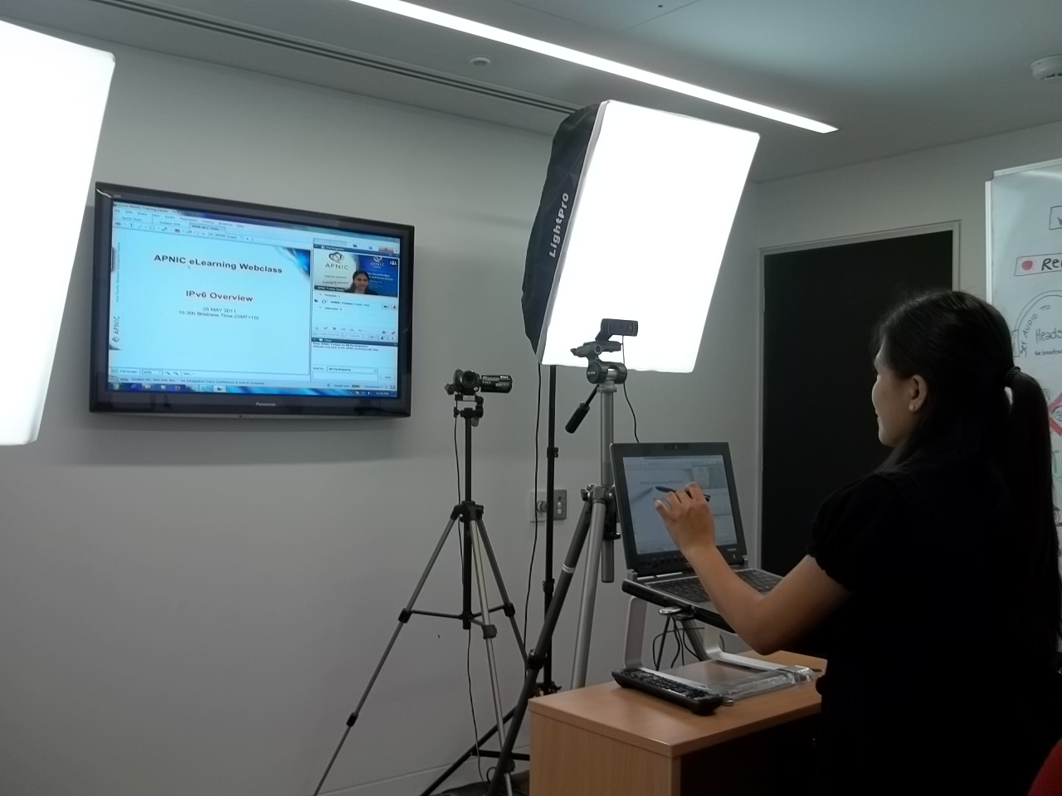
eLearning Media Room
A dedicated media room is set up to deliver eLearning sessions and remote presentations.

Slide 6
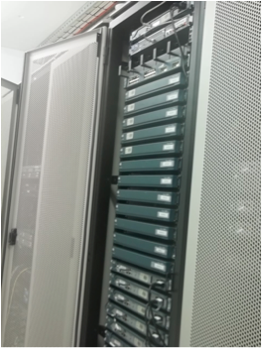
Training Lab
Training Lab infrastructure upgraded
Enables the training team to conduct advanced technical workshops to the APNIC community
Adds more value to training courses
Environment for other test scenarios
Network operations, infrastructure etc.

Slide 7
Policy Development Process
APNIC 31 – 11 proposals discussed:
Reached consensus:
prop-083: Alternative criteria for subsequent IPv6 allocations (Implemented)
prop-088: Distribution of IPv4 addresses once the final /8 period starts (Implemented)
prop-093: Reducing the minimum delegation size for the final /8 policy (Implemented)
prop-094: Adding alternative criteria to renumbering requirement in final /8 policy (Implemented)
prop-095: Inter RIR IPv4 address transfer proposal (Implemented)

Slide 8
Policy Development Process
Reached consensus:
prop-097: Global policy for post exhaustion IPv4 allocation mechanisms by the IANA (Pending remaining steps of global policy process)
Returned to mailing list for further discussion:
prop-096: Maintaining demonstrated needs requirement in transfer policy after the final /8 phase

Slide 9
APNIC 31 Meeting
APNIC 31 – on-site participation
426 APNIC delegates with 48 economies and 160 Member organizations represented
Remote Participation
33 participants in remote venues (PNG and Indonesia)
353 online remote participants
Notes:
*Web-based online participation figures are based on the number of unique IP addresses per session and exclude APNIC staff and on-site participants.

Slide 10
APNIC Coordinated Events
APNIC Conference
Continuing improvement plan
Investing in webcast equipment
Developed improved remote participation interface
Early site visit to venues
Participation in CommunicAsia
In coordination with dot.ASIA and APIA

Slide 11
Final /8 Implementation
Delivering the right message
Coordinated Final /8 campaign
Press Releases
Member communications
Close communication with the NIRs

Slide 12
IPv6 Program
IPv6 presentation in over 30 events in the AP region during 2011
APRICOT-APAN 2011
ICANN 41 IPv6 Session
SGNOG-1 Inaugural Session
Secretariat APIPv6TF
Several activities in intergovernmental organizations. (Details in Public Affairs report)
Notes:
Highlights==========* APRICOT-APAN 2011, Feb 2011Coordinated a full day IPv6 Transition Conference (over 600 participation)* ICANN41 IPv6 sessionOrganized an IPv6 Session in collaboration with ICANN and IANA* Supported the inaugural SGNOC meeting* Collaboration with ITU Asia Pacific: IPv6 WorkshopIPv6 Migration Strategy for Telecom Service Providers* Provide regional IPv6 activitiesdot.Asia, ISOC-HK, ISOC-PH, IPv6TF Thailand,

Slide 13
New Corporate Identity
We live in an IPv6 world now ::
Collaborative community ( )
Changing icon represents our dynamic and diversity community
New image for a new era

Slide 14
New Corporate Identity
Formal use

Slide 15
CMS Implementation
Content Management System
Streamlining content updates to APNIC website
Allows content specialists to update APNIC website following editorial best practices
Implementation of workflow
Giving content owners the ability to update website pages allocated to them
Significant ongoing training and video tutorials

Slide 16
Thank You

