Slide 1



IPv6 connection service by KISA
2010. 8. 24
Ji-Young Lee (leejy@kisa.or.kr)
IP policy & management team
Korea Internet & Security Agency

Slide 2




Overview (1)
6NGIX(AS17832)
  IPv6 Next Generation Internet eXchange
  Native IPv6 Internet eXchange run by KISA
  Provides IPv6 traffic exchange among ISPs and IPv6 connectivity for public/private organizationS
6NGIX
(IPv6 Next Generation Internet eXchange)
Notes:
2

Slide 3
Overview (2)
History of 6NGIX
  Jan ’01 : Allocated IPv6 Address for 6NGIX from APNIC
  Aug ’01 : Established 6NGIX
  Aug ’04 : Upgraded the performance of 6NGIX
  Nov ’07 : KRNIC took over the management right of 6NGIX
  Dec ’08 : Migrated the network from KIDC to KINX
Now & Then
  Originally focused on providing the R&D environment for IPv6 based Services and Devices
  Getting more requirements for IPv6 traffic exchange among commercial ISPs to prepare for the post IPv4 exhaustion
Notes:
3

Slide 4

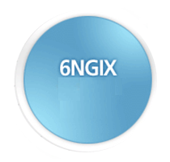

6NGIX Peering Status
KREONET
KOREN
Peering Status
  16 Korean ISPs
  5 Foreign ISPs
  16 Domestic Organizations
KINX
SK
Broadband
DreamLine
LG
Dacom
KT
National
Information
Network
KT Freetel
KT
Infra
Research
Center
SK
Telecom
LG
Telecom
HINet
(Taiwan)
(AS: 17832)
Domestic : 16
Foreign : 5
Layer 3 Peering Service
Peering Methods
: Leased Line, 6to4
Tunneling
Routing Protocols
: OSPF, BGP, IS-IS,
BGP4+
Samsung
Networks
Hurricane
Electronics
(America)
SK
Networks
CBN
(Indonesia)
Han
Internet
BT
(United
Kingdom)
Domestic :
16
Piranha
Systems
Server
Bank
CNNIC
(China)
Notes:
4

Slide 5
6NGIX in KRNIC
6NGIX in KRNIC
  When allocating IPv6 to ISPs, we let them know about 6NGIX and recommend them to peer with 6NGIX
  ➔ Lead the local ISPs to peer with the real IPv6 network
  Conducts the 6NGIX-linked IPv6 project with local ISPs
  ➔ Supports the continuous traffic exchange with the previously built
  IPv6 service
  Shares the experience and know-how about building and managing IPv6 network with network operators
  ➔ Lessons network operators’ fear about building IPv6 networks
  Creates the successful IPv6 network model in Korea
Create the synergy for IPv6 in Korea by combining 6NGIX
peering service with the previous IPv6 allocation work
Notes:
IPv6 할당 업무와 IPv6 연동 업무를 KRNIC에서 수행함으로써
국내 IPv6 환경 조성
5

Slide 6
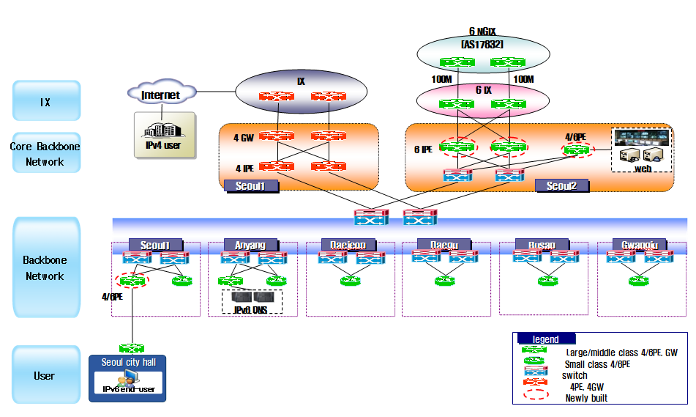
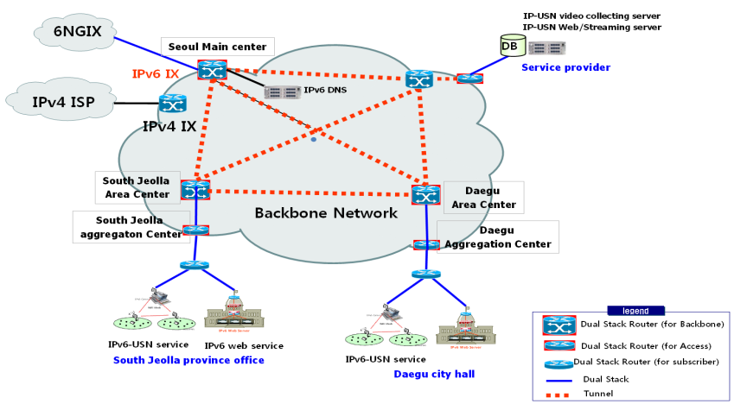
IPv6 Project of 2009
  In 2009, 3 Major ISPs, 8 local government and commercial service providers
  participated in ‘IPv6 Core Network building project’:
  To build IPv6 Core Network as a ISP’s production network.
  To increase IPv6 Readiness on ISP’s backbone network
  To verify stability for building large-scale IPv6 production network
IPv6 Core Network Building Project
Group A
– IPv6 over MPLS (6PE)
Group B, C
– Dual Stack on existing IPv4 network
Each group secured more than one path for IPv6 with 6NGIX
Notes:
6

Slide 7







IPv6 Project of 2010 (1)
We are conducting project about IPv6 over WCDMA
DHCPv6 Development for WCDMA Mobile Equipment
Supporting IPv6 Communication function between GGSN equipment and Core Networks
6PE over MPLS Networks Building
Interworking between 6NGIX and SKT IPv6 WCDMA Networks
IPv6-based Mobile Service Project
IPv6 over WCDMA
BB Access Networks
IPv6 Core Networks
IPv4/IPv6 Session
IPv6 Network
6NGIX
MPLS
Networks
IPv6 App Service
Smart Phone
(IPv4/IPv6)
RNC
SGSN
GGSN
(IPv4/IPv6)
6PE Router
(IPv6)
6PE Router
(IPv6)
Twitter
Server
(IPv4/IPv6)
IPv6 module porting in WCDMA Mobile
Equipment OS Kernel (Google Android)
Notes:
7

Slide 8
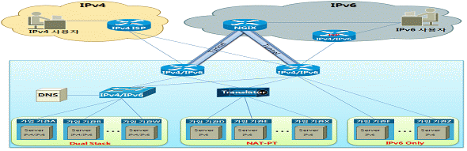
IPv6 Project of 2010 (2)
IPv6-based Commercial Web Service Project
  Builds the infrastructure and provide the IPv6 based web service with commercial contents providers in Korea
    provide the IPv4/IPv6 dual stack server hosting
    peer with 6NGIX and other IPv6 network
6NGIX
Notes:
8

Slide 9
Summary
6NGIX : the only IPv6 IX in Korea
- Has been played a key role in IPv6 deployment projects
in Korea
More ISPs are connecting with 6NGIX as the IPv4 exhaustion is getting closer
- 26 org. (Dec ‘08) → 37 org. (May ’10)
From 2010, commercial IPv6 traffic will be peered in 6NGIX as ISPs plan to launch commercial IPv6
If you’re interested in connecting 6NGIX,
contact us and get connected!!
Notes:
9

Slide 10
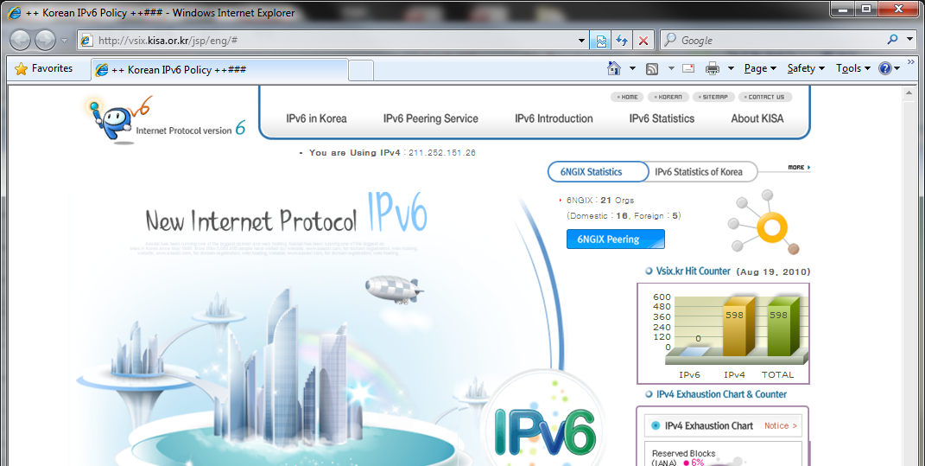
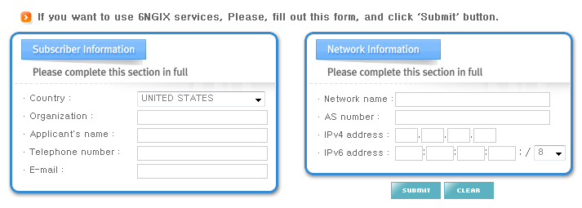
6NGIX Peering Request
Visit http://vsix.kr web site
Fill in the 6NGIX service peering request form and submit the request to KRNIC
※ This website will open in Sep 2011
Notes:
10

Slide 11

Thank you!
v6webmaster@kisa.or.kr

