Slide 1
Final Stages of IPv4 Distribution
Guangliang Pan
Resource Services Manager,
APNIC

Slide 2
Introduction
IPv4 address distribution will move to the final stages in the next few years
This presentation is an overview of what is going to happen
We would like to seek community’s opinions on how APNIC could manage the IPv4 address distribution during the final stages

Slide 3
Status of IPv4 Address Space
Available unallocated
Pool 14
AfriNIC 2
6 August 2010

Slide 4
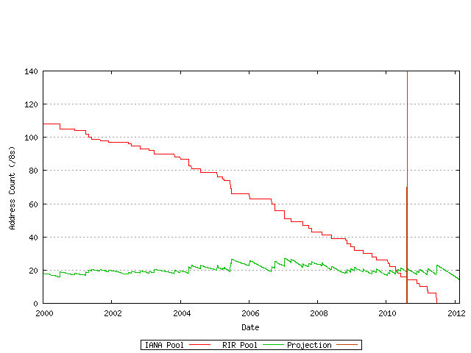
Projected Exhaustion of IANA Unallocated Pool
http://www.potaroo.net/tools/ipv4/

Slide 5
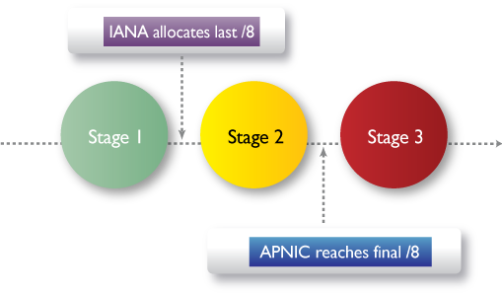
Final Stages of IPv4 Distribution

Slide 6
Stage 1
IANA Unallocated Pool Still Available

Slide 7
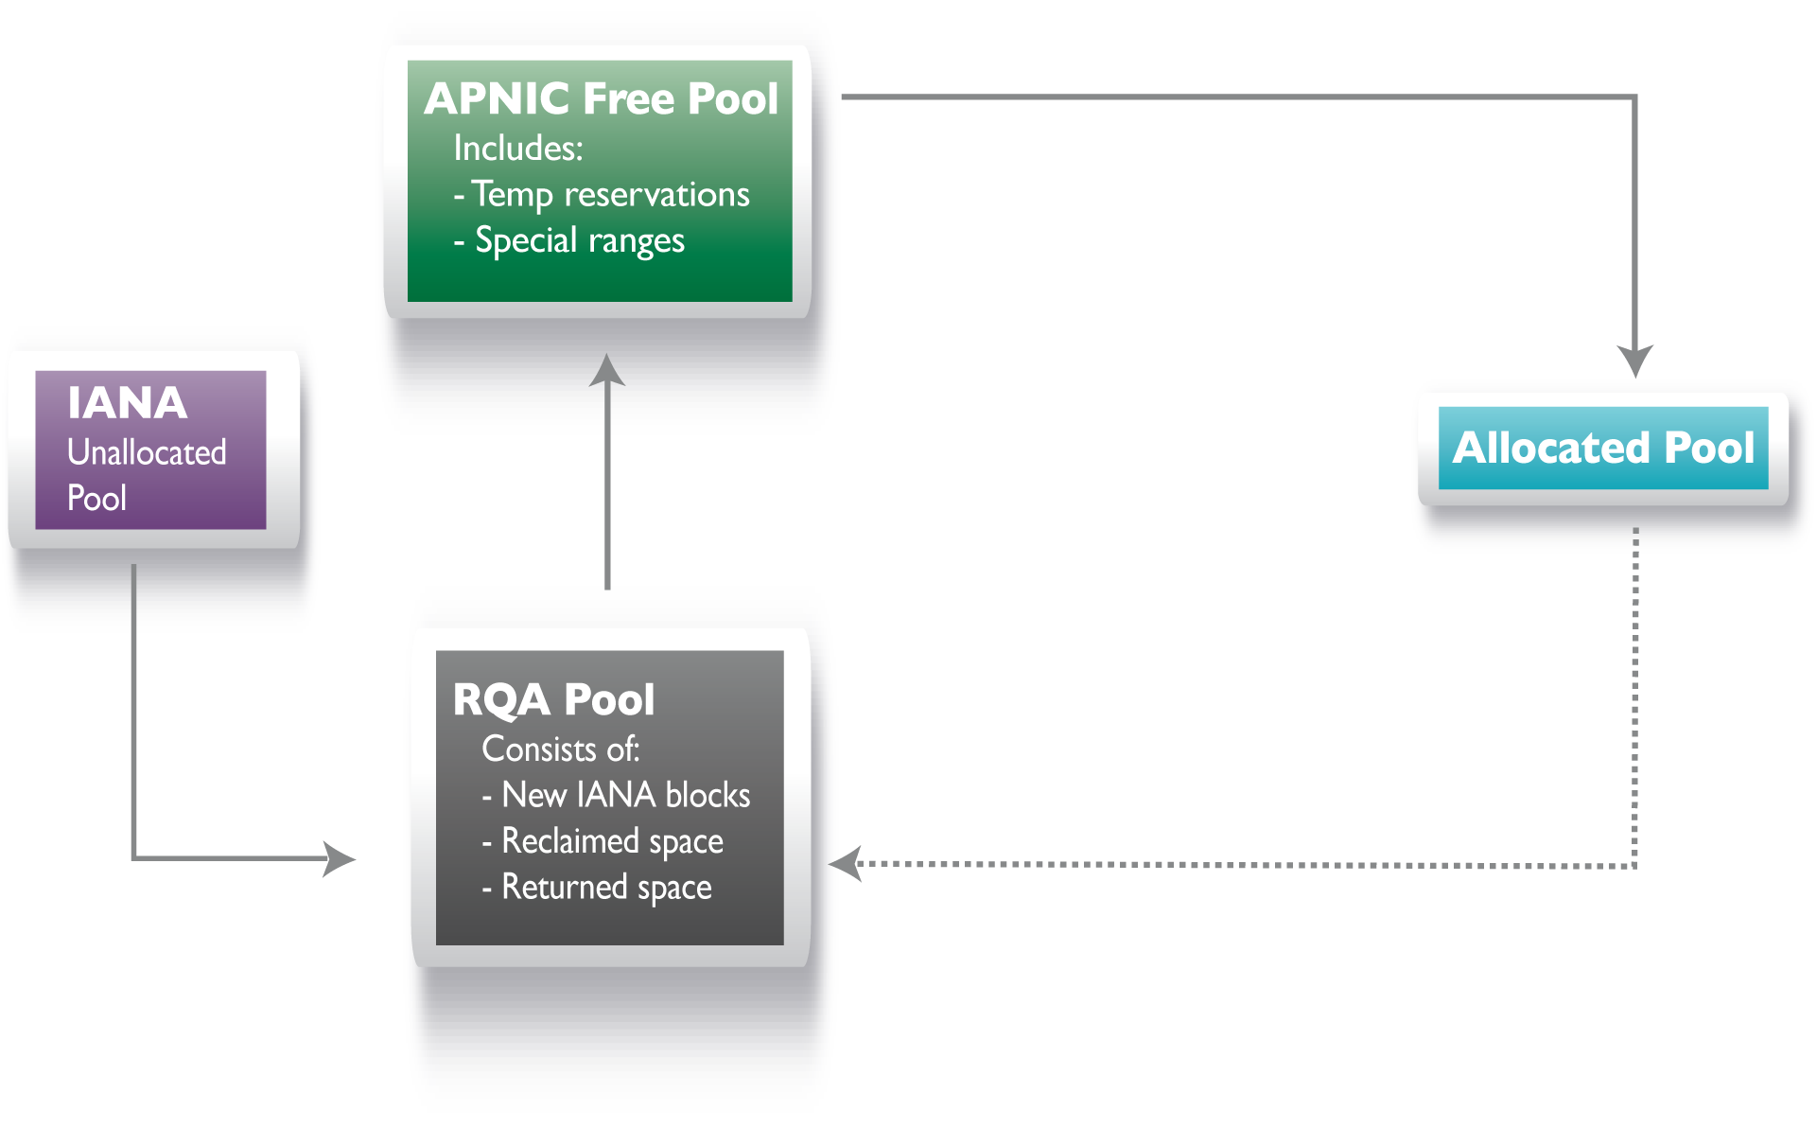
IPv4 Address Pool at Stage 1

Slide 8
What Happens During Stage 1
APNIC will continue to follow current policies to distribute IPv4 addresses
All allocations will be based on equipment capacity and customer numbers
Current escalation procedure will continue to apply

Slide 9
Escalation Procedure
If the request size
>= /19, request must be approved by two Hostmasters
>= /17, request must be approved by Resource Services Manager
>= /15, request must be approved by Senior Manager Review Team

Slide 10
Resource Quality Assurance
Assess new IANA allocated /8 blocks
Quarantine reclaimed and returned address space for 12 months
Minimize any routability problems through communication, training, and testing

Slide 11
Stage 2
Post-IANA Pool

Slide 12
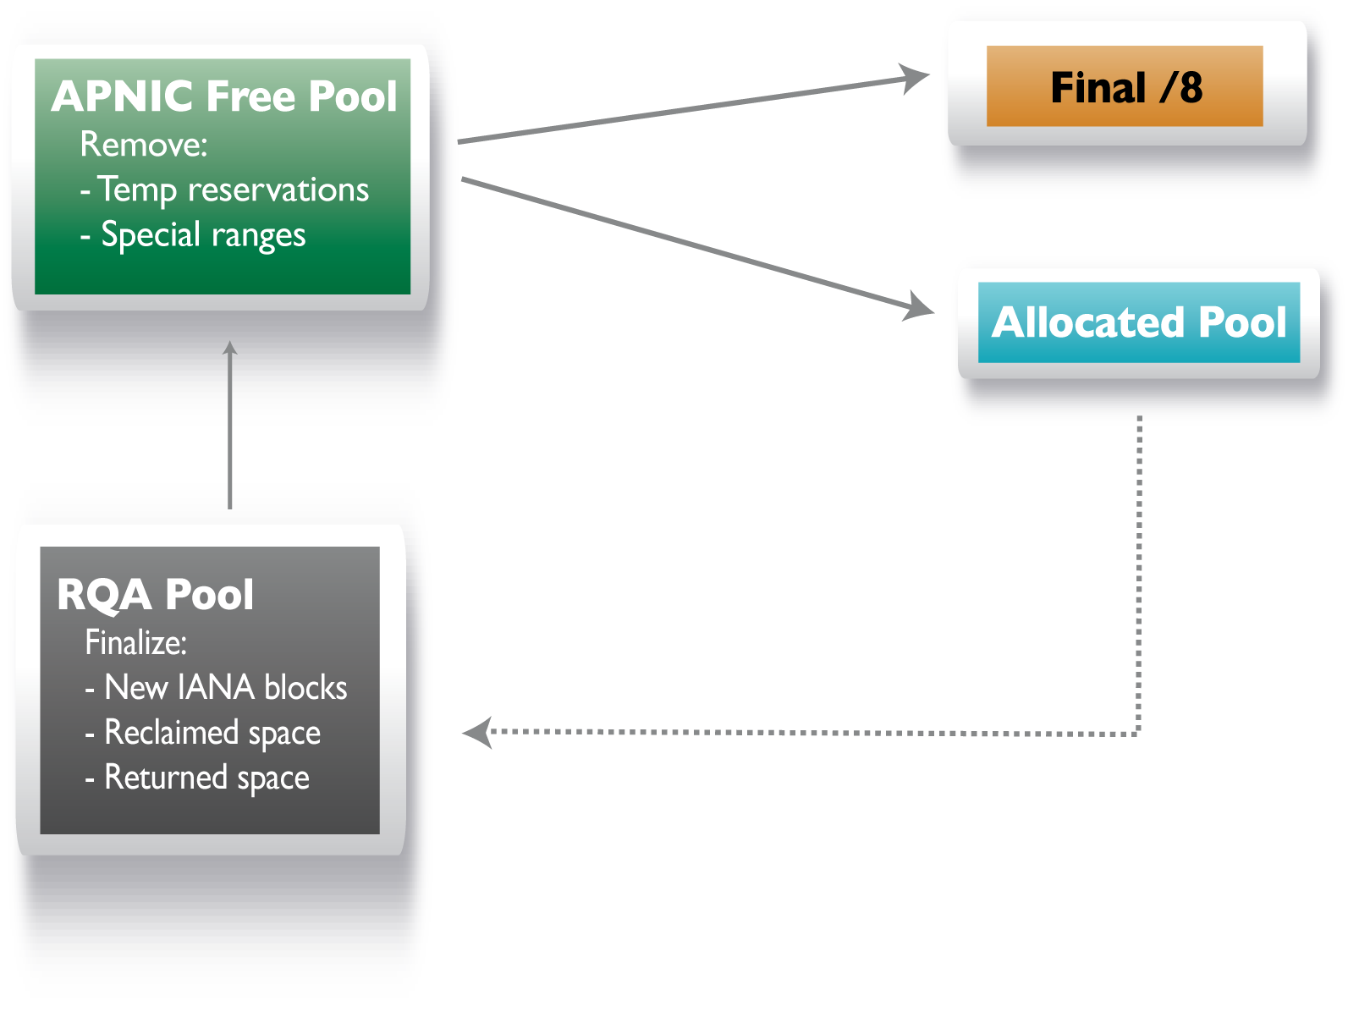
IPv4 Address Pool at Stage 2

Slide 13
Reserving the Final /8
The advantages of reserving the last IANA /8 block are:
The last block will be clean as IANA has reserved five clean blocks for the five RIRs
It is easy for APNIC to manage the final /8 allocations and records
Easier to identify other recyclable or transferable ranges

Slide 14
Reserving the Final /8 (cont.)
The disadvantage of reserving the last IANA /8 block is:
It will create some fragmentation when there is a large request and we only have small prefixes to make up the allocation size without using the reserved final /8 block.

Slide 15
Continuing to Allocate all Available Space
All reserved ranges except the final /8 will be released
One allocation may combine multiple prefixes to make up the required allocation size

Slide 16
Finalizing the RQA Pool
At the end of Stage 2, Hostmasters will make a final review of the RQA pool, searching for any usable address space

Slide 17
IPv4 Address Transfers
Members may start using IPv4 transfer policy
All such transfers will be subject to APNIC Hostmasters’ evaluation at this stage

Slide 18
Stage 3
APNIC Reaches Final /8

Slide 19
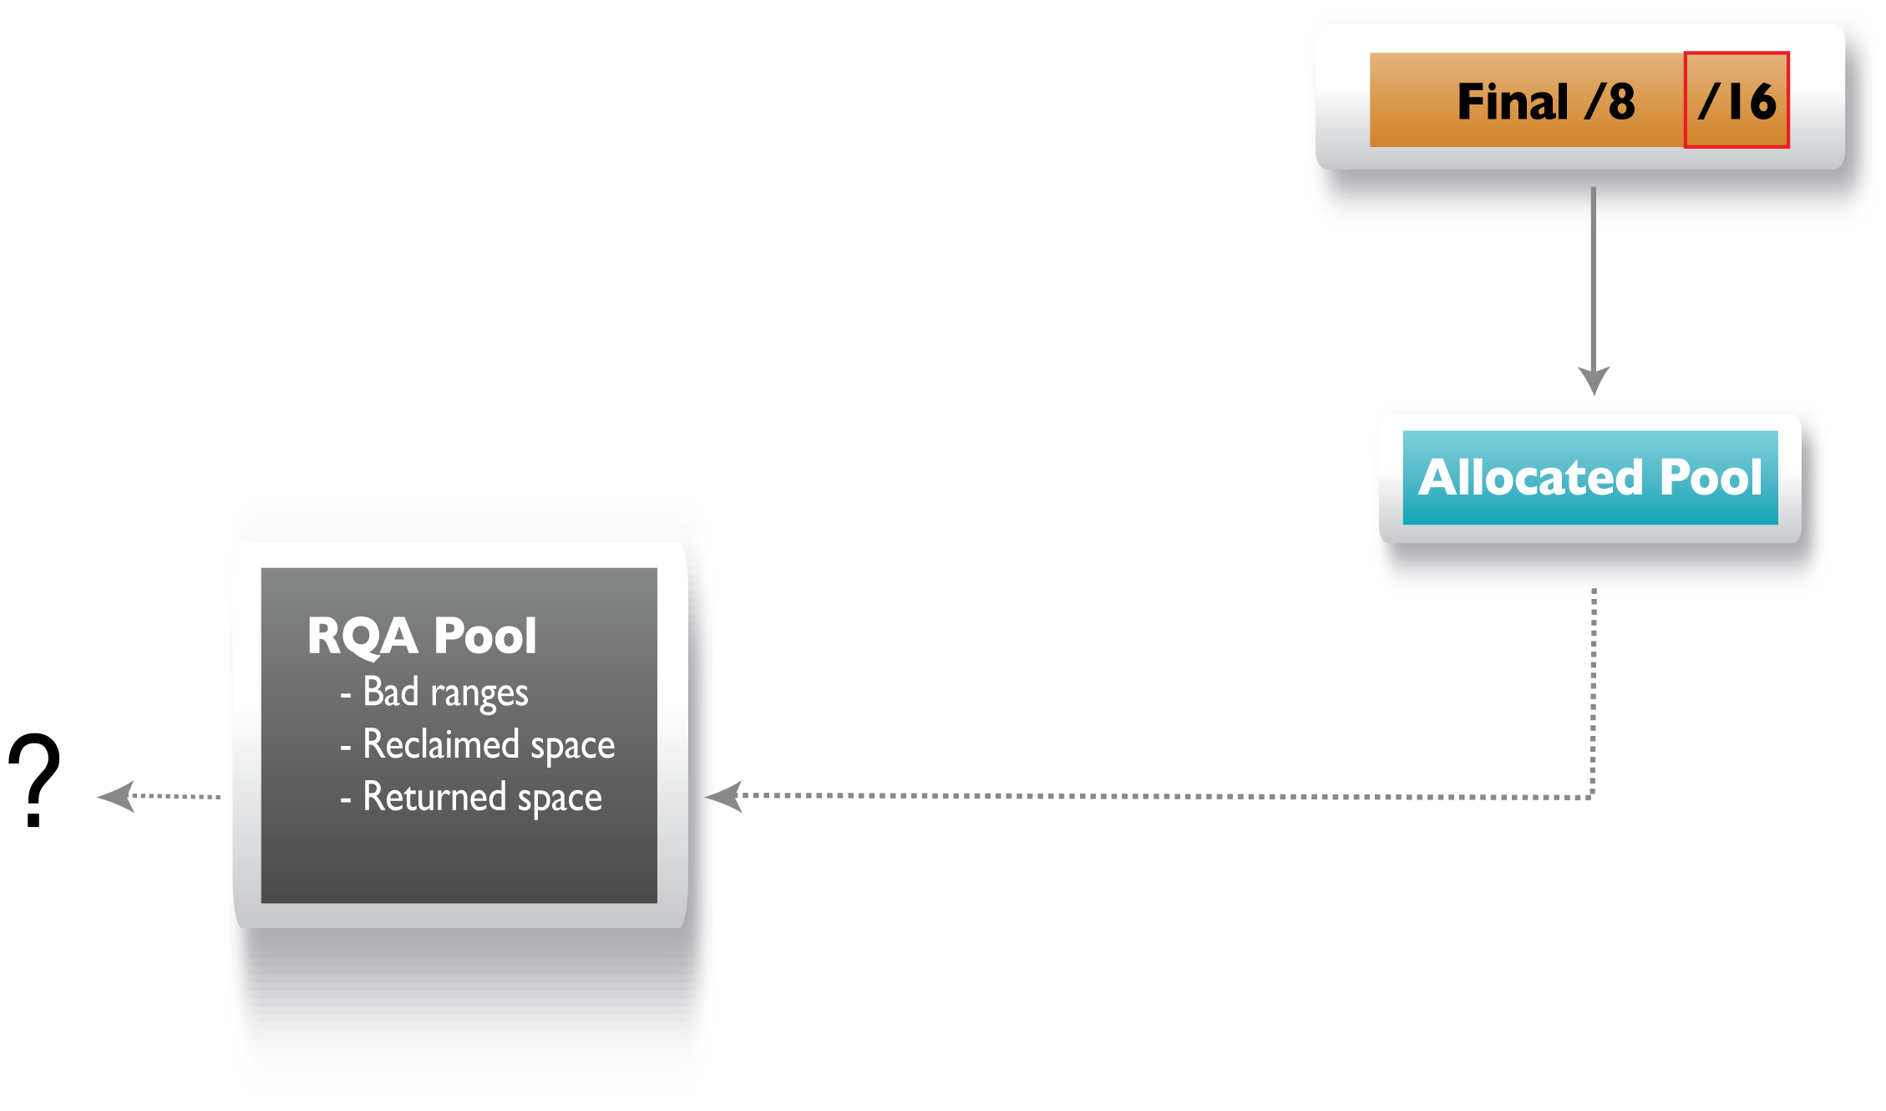
IPv4 Address Pool at Stage 3

Slide 20
Use of Final /8
One /16 block will be reserved for future uses, as yet unforeseen
Allocations will be made according to the final /8 policy
Each LIR can only receive one allocation of the minimum allocation size

Slide 21
IPv4 Address Transfers
MyAPNIC will provide a streamlined transfer process
Hostmasters’ evaluation will not be necessary at this stage

Slide 22
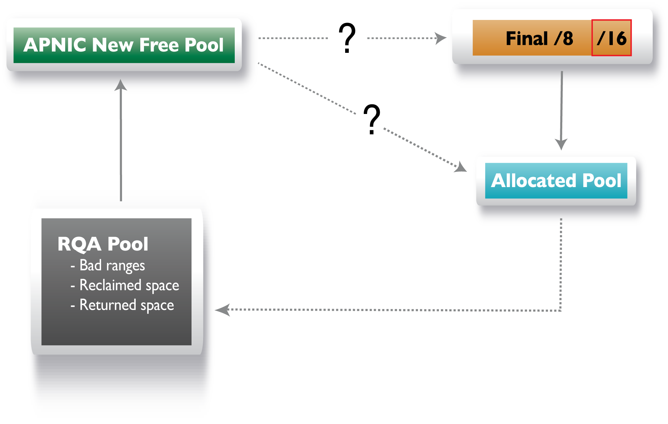
Questions?

Slide 23
What Should We Do Next ?
Propose a new policy to manage recycling IPv4 address space?
Move to IPv6 as early as possible?
More ……

Slide 24
Summary
Stage 1: IANA unallocated pool still available
Stage 2: Post IANA pool
Stage 3: APNIC reaches final /8
and
The future ……

Slide 25
Final Stages of IPv4 Distribution

Slide 26
IPv4 Address Pool at Stage 1

Slide 27
IPv4 Address Pool at Stage 2

Slide 28
IPv4 Address Pool at Stage 3

Slide 29
Questions?

Slide 30
Thank you!
<gpan@apnic.net>

