Slide 1
Resource Certification in MyAPNIC
Robert Loomans
Senior Software Engineer, APNIC
Notes:
Creative: Servicing own car
How many people have a new car and lift the bonnet?
Treat the car like an appliance.
Resource certification (PKI) had lots of moving parts – don’t really want to know about the gory details

Slide 2
Resource Certification in MyAPNIC
Focus on tasks
MyAPNIC pages
Future direction

Slide 3
Focus on Tasks
What do you want done?
Focus on tasks and resources…
… not certificates
Complex details, if you want them
Notes:
Note: done – past tense: people don’t want to do these things, they want them done. Does not mean “intuitive”
This is a distillation of what I only realised after the fact. (Thank you Geoff, George)

Slide 4
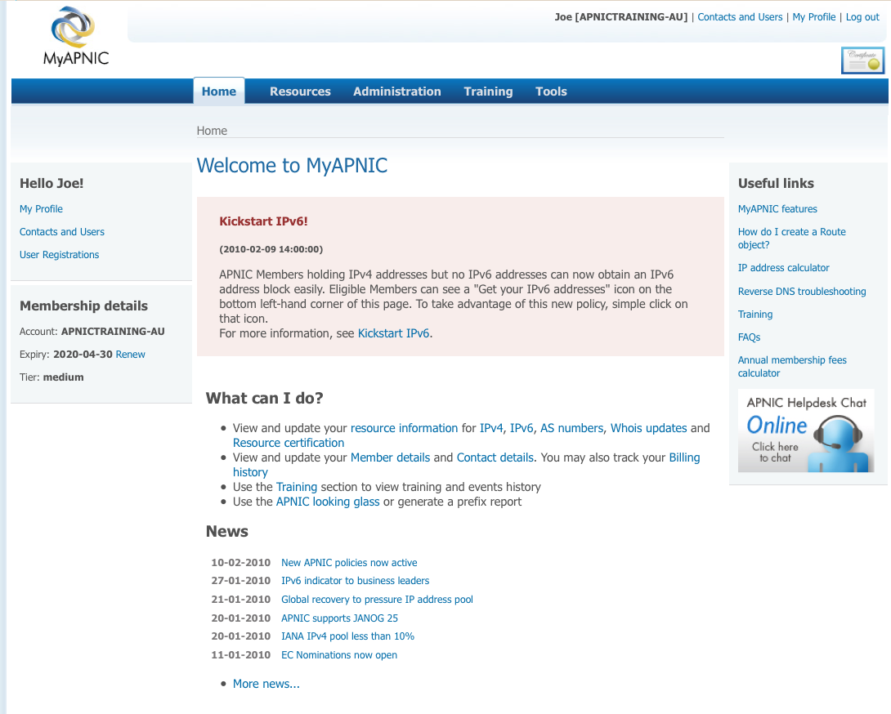
MyAPNIC Home Page

Slide 5
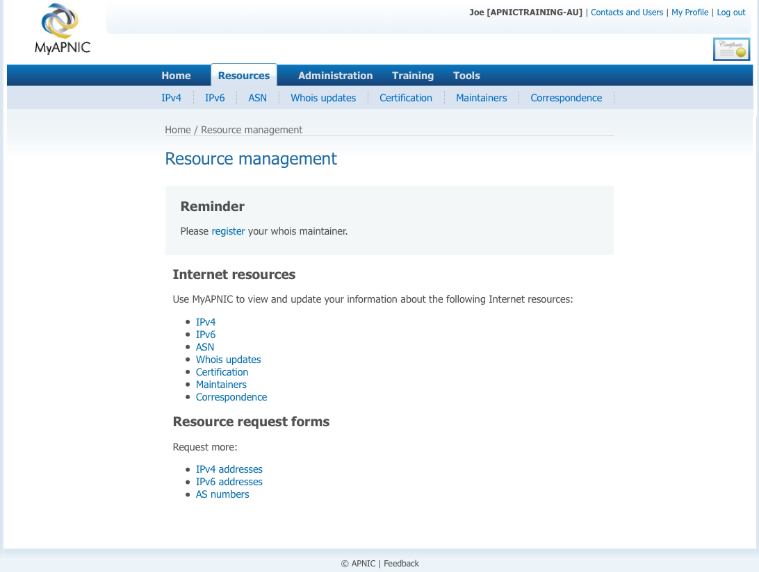
Resources Management

Slide 6
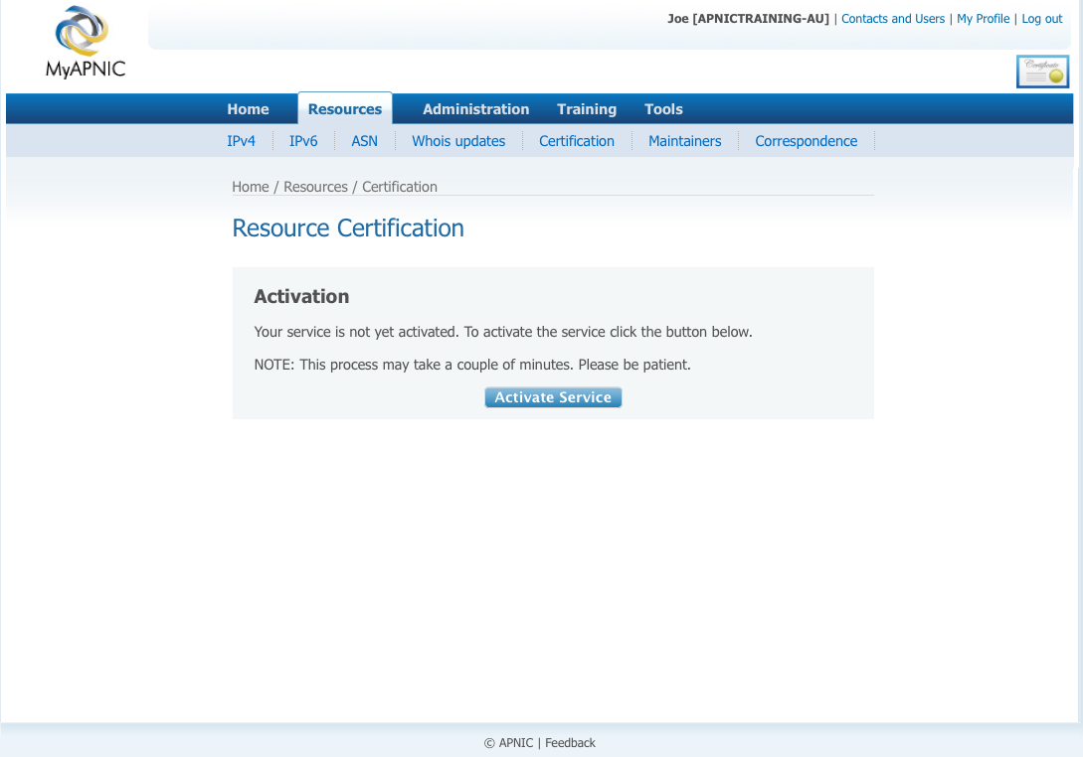
Activate Certification

Slide 7
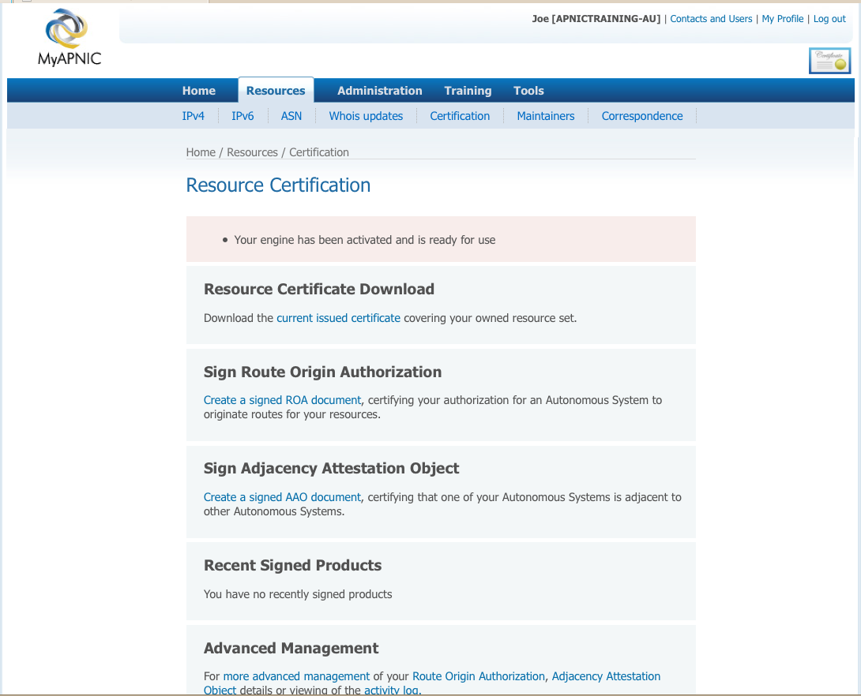
Service Activated

Slide 8
Create Route Origin Authorization

Slide 9
Name ROA

Slide 10
Add Resources
Notes:
From a collection, or the list…

Slide 11
Add Resources
Notes:
… or enter manually.
(Good for specifying parts of networks)

Slide 12
Add AS
Notes:
Originating AS

Slide 13
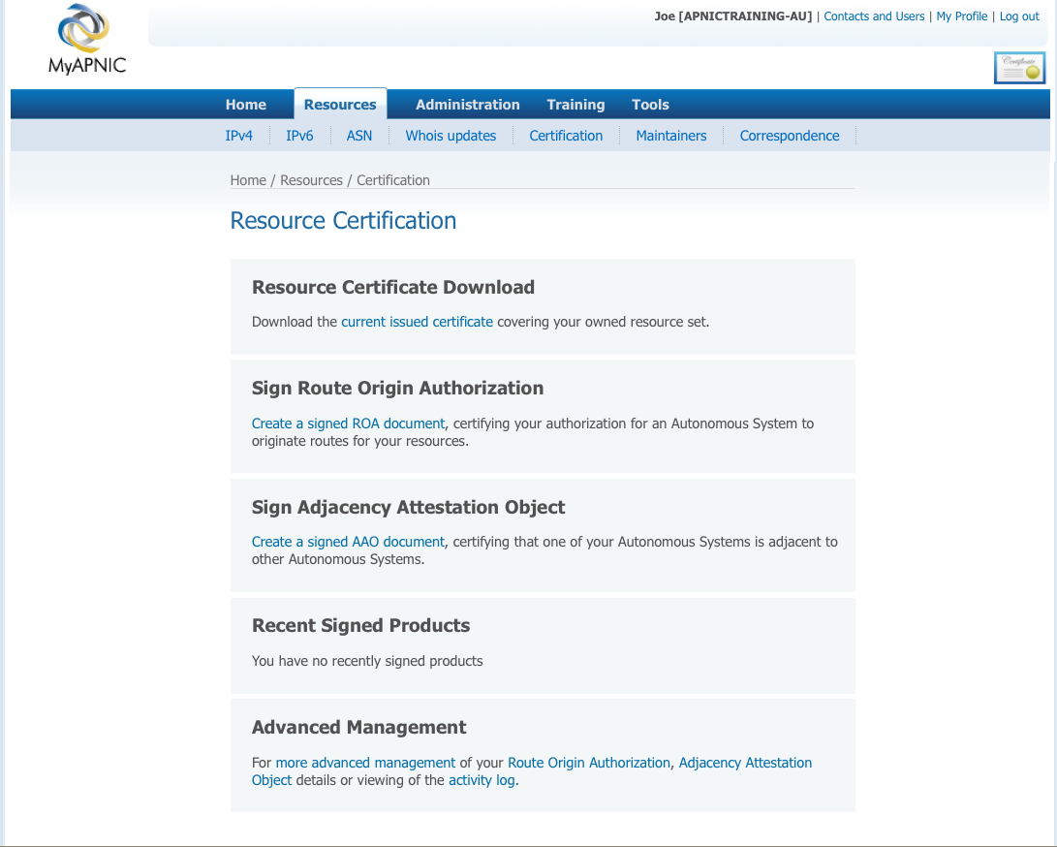
Advanced Management

Slide 14
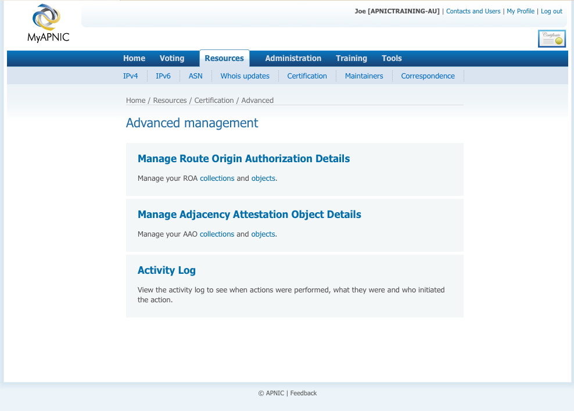
Route Origin Authorization (ROA)

Slide 15
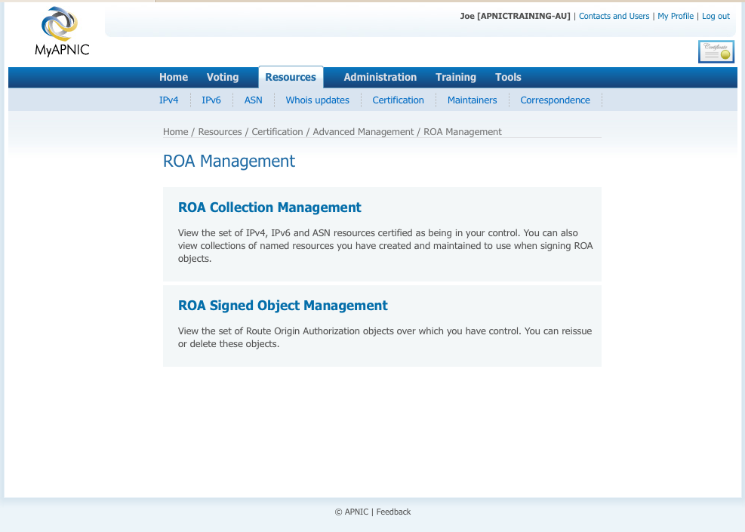
ROA Collection Management

Slide 16
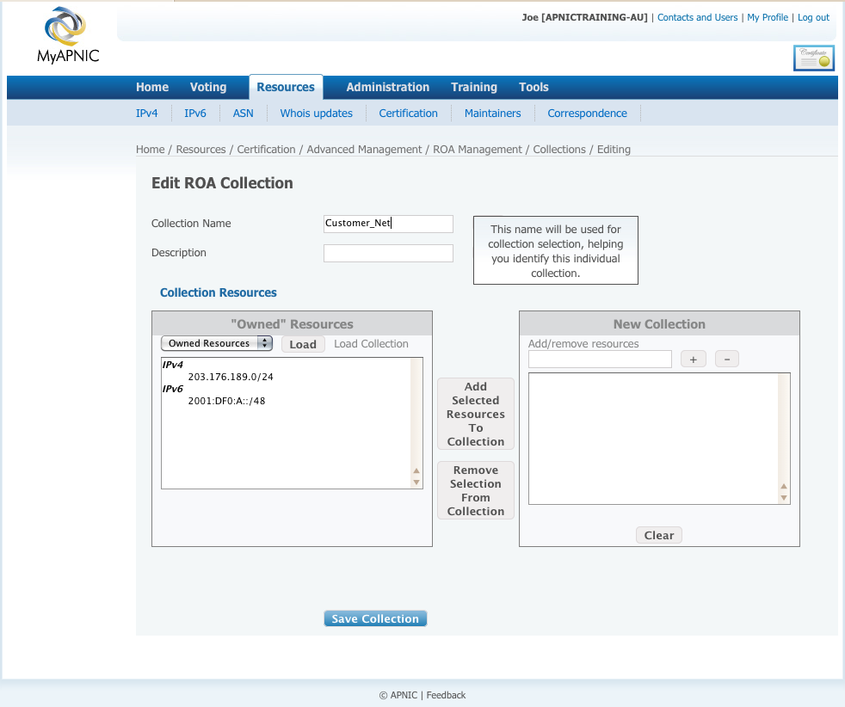
Add ROA Collection

Slide 17
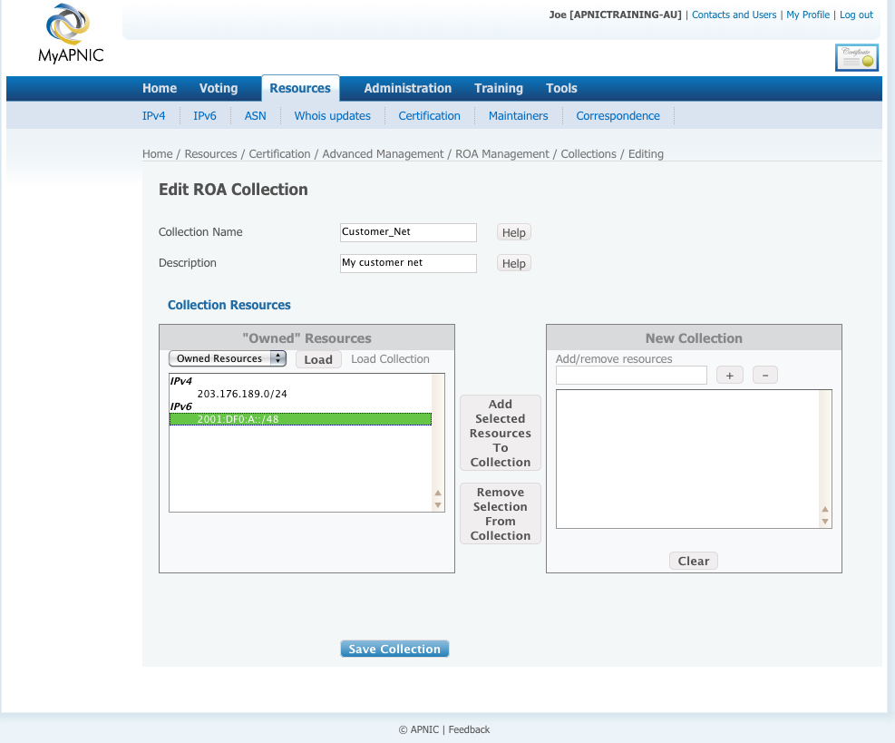
Add ROA Collection

Slide 18
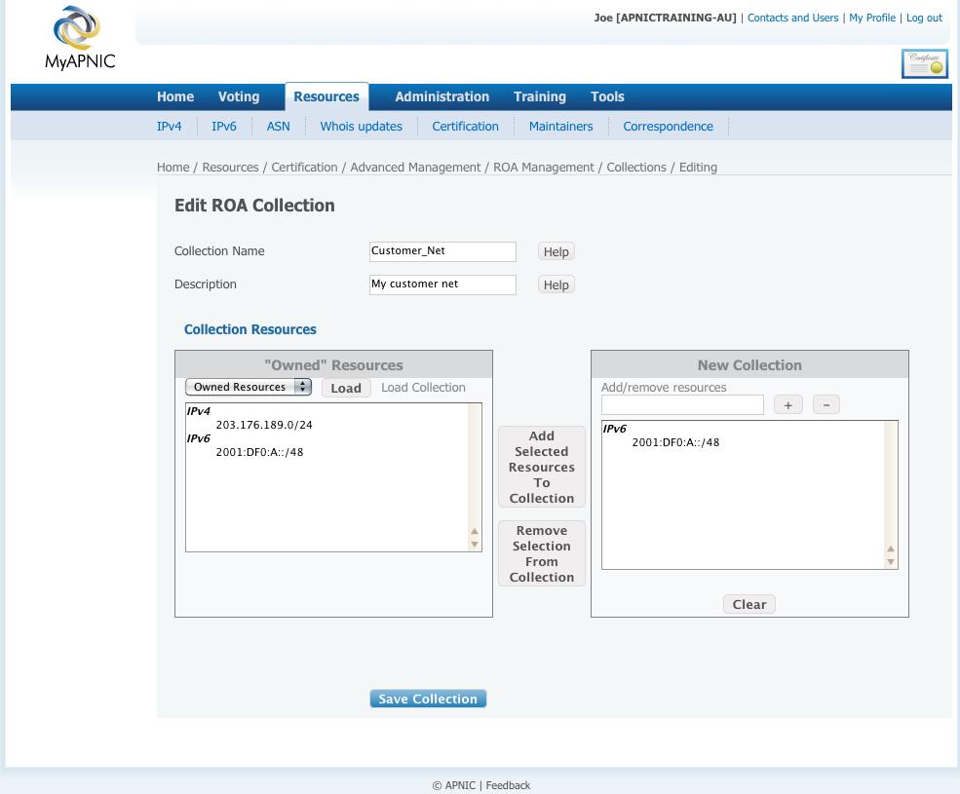
Add ROA Collection

Slide 19
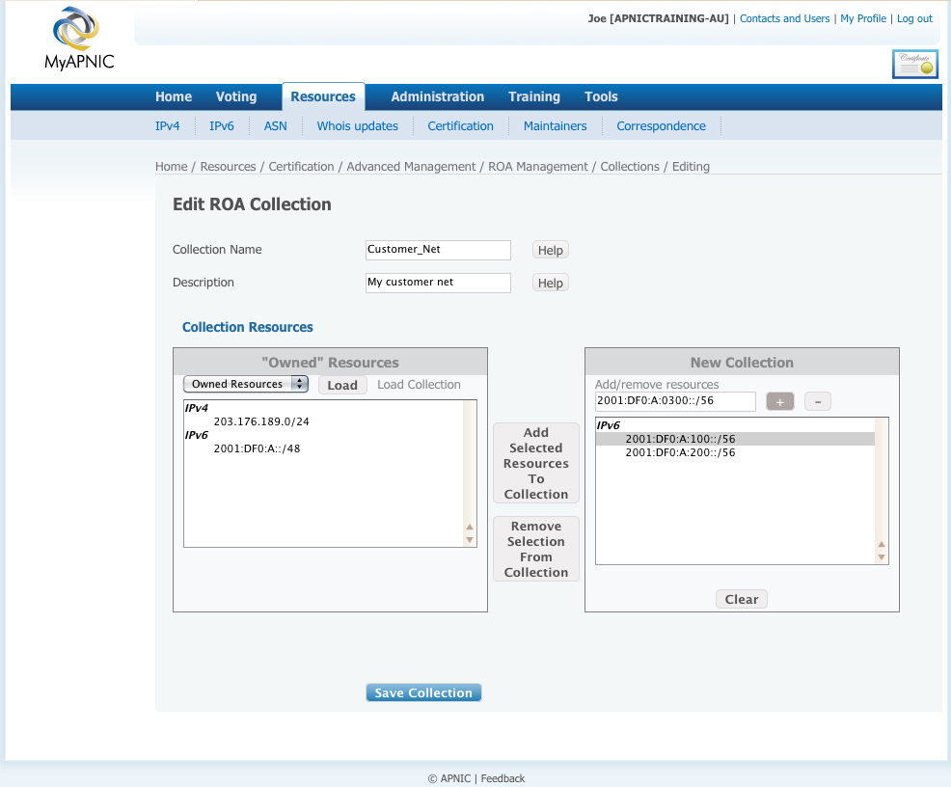
Add/Remove Resources

Slide 20
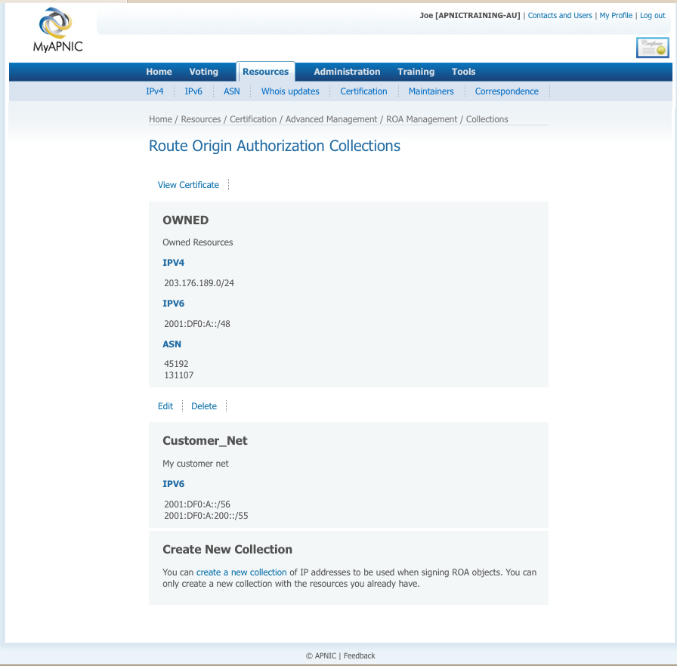
View & Update Collections

Slide 21
Download Certificate

Slide 22
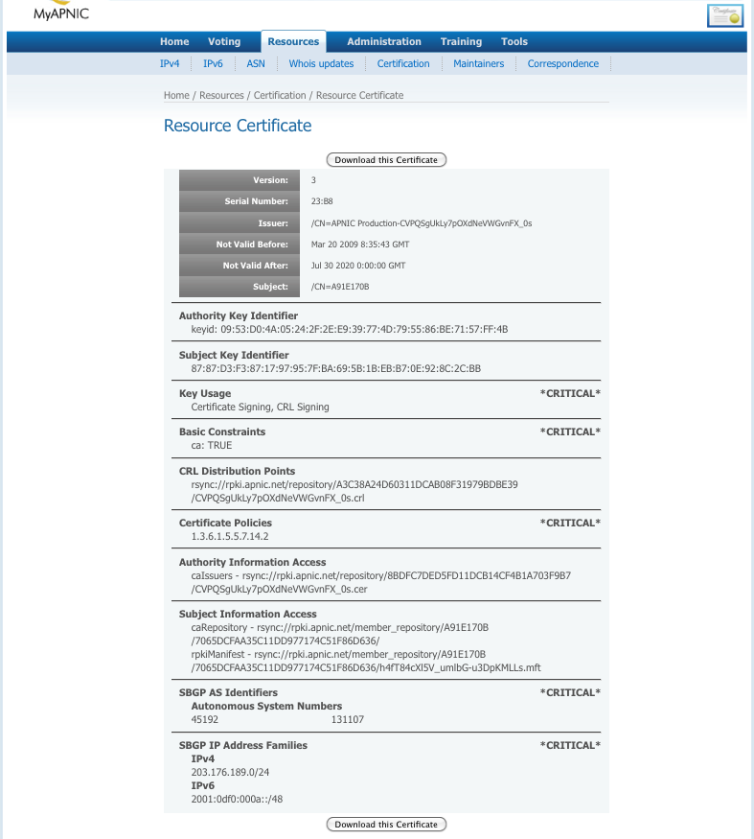
Download Certificate

Slide 23
Future
“General purpose” signer
Verifier

Slide 24
General Purpose Signer
MyAPNIC only
Upload a file
Download
a detached signature
a signed package

Slide 25
Verifier
Public website
Upload
a file and signature
signed package
signed object (ROA, etc.)
Verify signature
Show certified resource details
Download package payload

Slide 26
Resource Certification in MyAPNIC
Focus on tasks
MyAPNIC pages
Future direction

Slide 27
Questions?
Thank You!
RobertL@apnic.net

