Slide 1
APNIC Member Meeting
NRO Number Council Election

Slide 2
Composition of NRO NC
Defined by NRO MoU
3 members from each region
  1 member appointed by Board of each RIR
  2 members selected via regional policy forum of each RIR
Selection process decided by each RIR
  http://www.nro.net/documents/nro1.html

Slide 3
NRO NC Selection – APNIC
As determined by APNIC EC
One member appointed by APNIC EC annually, for 1-year term
Two members elected during the APNIC Member Meeting (AMM)
  One member elected each year, for a 2-year term (staggered)
  Election not governed by the APNIC Bylaws, but to be conducted in the general manner described there

Slide 4
APNIC NC Election 2010
One vacant seat on NRO NC
  2-year term until 31 Dec 2012
Call for nominations ended 26 Jul 2010
  http://www.nro.net/news/CallforNominations-APNIC.html
Online and onsite voting available
  http://www.apnic.net/nro-election-process

Slide 5
Voting Entitlement
Online voting
  Started: 13 Aug 2010
  Ended: 9:00 (UTC+10) on 25 Aug 2010
  Each APNIC Member organization is entitled to 1 vote via MyAPNIC
Onsite paper voting
  Open now until 14:00 (UTC+10), 27 Aug 2010
  Each registered AMM attendee* is entitled to 1 vote, as an individual
  Collect your ballot paper from meeting registration desk
  APNIC and other RIR staff do not vote
* At any meeting since APNIC 10

Slide 6
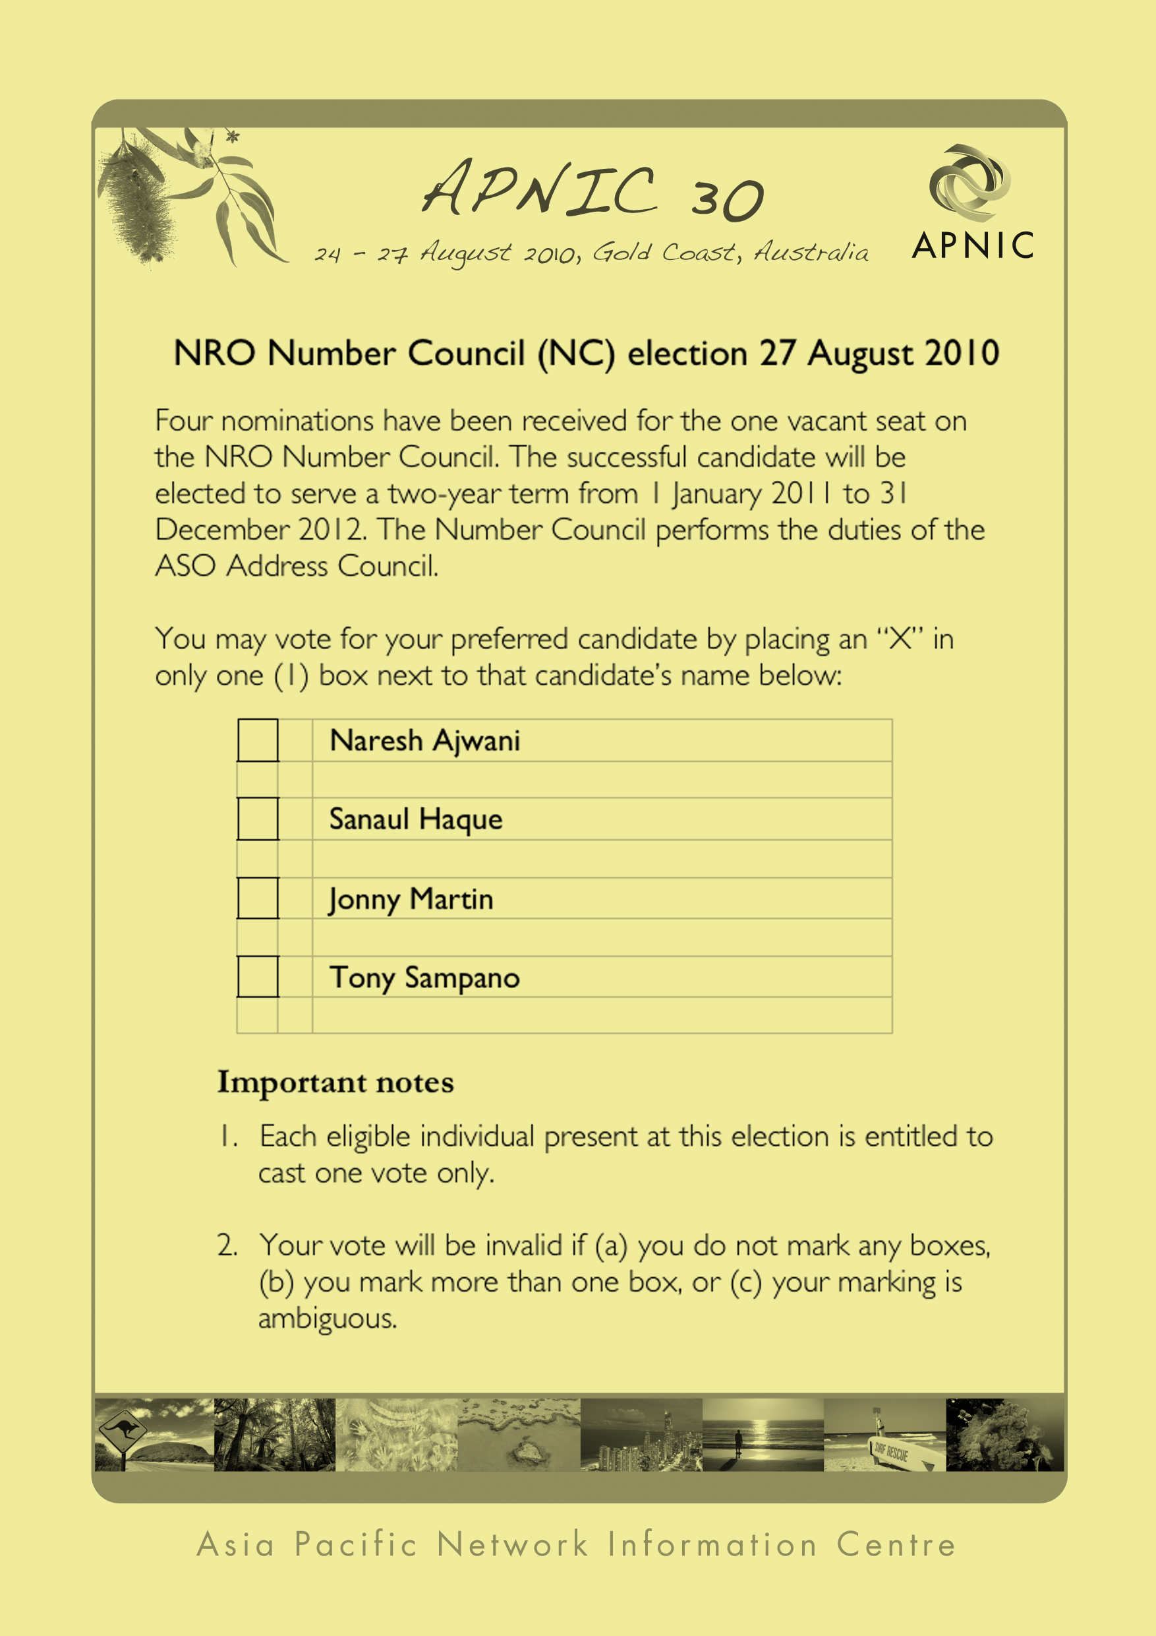
NRO NC Election Ballot

Slide 7
Onsite Voting Procedure
All ballot papers are stamped
Please mark only one box with an “x”
A ballot paper is invalid ballots if:
  No boxes are marked
  More than one box is marked
  Ambiguous marking
Ballot box at registration desk
Onsite voting open until 14:00
Result announcement around 16:00

Slide 8
Election Review Panel
ERP report made recommendations regarding the APNIC EC Election process
APNIC EC is currently considering ERP recommendations
  For next APNIC EC Election, February 2011
APNIC EC has adopted the following procedures for the NC Election

Slide 9
Chair of Election
For purposes of this election the Chair of the APNIC EC will serve as Chair of the Election

Slide 10
Election Tellers
Tellers are appointed by the Chair of the Election to count the votes
Tellers will be drawn from APNIC Secretariat staff

Slide 11
Election Scrutineers
Scrutineers are appointed by the Chair of the Election to observe vote count, and ensure its integrity
Scrutineers will be drawn randomly from staff of other RIRs who are present at this meeting

Slide 12
Content of Announcement
The result will be announced by the Chair of the Election
This announcement will include:
  Name and total vote count received by each candidate in election
  Total number of ballots cast and number of invalid ballots

Slide 13
NRO NC Election Candidates
Naresh Ajwani
Sanaul Haque
Jonny Martin
Tony Sampano

Slide 14
Questions?

