Slide 1


IETF: Internet Evolution Turbo Facilitator
Xiaodong LEE
APNIC@Beijing
2009

Slide 2
Major Standards Organization for Internet
IETF: Internet Engineering Task Force
Internet based protocols
W3C：World Wide Web Consortium
Web based protocols
OASIS：Organization for the Advancement of Structured Information Standards
E-commerce related standards
ITU：International Telecommunication Union
Telecom based standards

Slide 3
IETF “Standards”
IETF standards: a de-facto standard for Internet
No formal recognition for IETF standards
Many standards organization refer to IETF protocols
Some government standards refer to IETF standards
Internet companies implement them
A lot of people use IETF protocols

Slide 4
IETF Standard Facts
More than 90% of Internet Standards are created by IETF（Internet Engineering Task Force），including：
Internet base protocol: TCP/IP
Browsing Web: HTTP
Email Service: SMTP、POP、IMAP
Domain Name Resolution: DNS
File Downloading: FTP
Other Protocols such as routing, SNMP

Slide 5






IETF Contribution to Internet
FTP
SIP
IDN
HTTP
Email
MPLS
EAI
Telnet
DNS
…
UDP
BGP
OSPF
…
TCP
LDAP
IP
ARP
Internet
IETF leads the Internet to flourish for more than 20 years

Slide 6
IETF Overview
The Internet Engineering Task Force (IETF) is a large open international community of network designers, operators, vendors, and researchers concerned with the evolution of the Internet architecture and the smooth operation of the Internet.
IETF is founded in early 1986
It is open to any interested individual.
Recent meeting participants: around 1000

Slide 7
Dots
IAB member (red)
IESG member (yellow)
Working Group chair (blue)
nomcom (orange) – they came to listen to you...
local host (green)
others, maybe even drums and ornaments ...

Slide 8
IETF Documents
all open - no “confidential contributions”
  Any document can be find online
  Anyone with the email can give the comments
  Any decision is not decided secretly
developed as Internet-Drafts
  anyone can submit - “expire” in 6 months
  some I-Ds are working group documents
published as RFCs
  archival publications (never changed once published)
  different types: (not all RFCs are standards!)
    informational, experimental, BCP, standards track, historic
3-stage standards track, under review in NEWTRK
  Proposed Standard, Draft Standard, Internet Standard

Slide 9
IETF and Other related Organization
ISOC
ICANN
Co-operation
IAB
IANA
IRSG
IESG
IRTF
IETF
Area
Directors
IETF
WG
IETF
secretariat
RFC
Editor

Slide 10
IETF
Application
General
Internet
Operation
Real time
Routing
Security
Transport
calsify
ipr
16ng
bmwg
avt
bfd
btns
behave
IDNAbis
tf
6man
dime
bliss
ccamp
dkim
ippm
eai
ancp
dnsop
ecrit
idr
emu
nsis
httpbis
csi
grow
enum
isis
hokey
pcn
imapext
dhc
imss
geopriv
ospf
isms
rmt
lemonade
dna
ipfix
iptel
pce
ltans
rohc
ltru
dnsext
opsec
sip
roll
msec
tcpm
sieve
eap
radext
sipping
sidr
nea
tsvwg
usefor
…
…
…
…
…
…
vcarddav
hip
v6ops
p2psip
rtgwg
tls
dccp
10
2
28
17
16
16
17
13
More than 100 WGs

Slide 11
IETF Working Group
no defined membership
  just participants
  Any individual, not company
Anyone with the email address can join it
Workshop for producing drafts and rfcs
Major work is on mailing lists
Face-to-Face meeting is to discuss and decide some very important things
“Rough consensus and running code...”

Slide 12
WG Principal: Rough Consensus
"We reject kings, presidents and voting. We believe in rough consensus and running code."
-- Dave Clark

Slide 13
Rough Consensus
Clearly dominant agreement
Does not have to be unanimous
Judging consensus can be hard w/o voting
    humm
    show of hands
May discard parts to get consensus on rest
    May discard the part which can not have a consensus
    Consensus on the part which can have a consensus

Slide 14
Appeals Process
IETF decisions can be appealed
start appeal at level above decision being appealed
1st to WG chair
only then to Area Director
only then to IESG
only then to IAB
if claim is that the process has not been followed,
only then an appeal can be made to the ISOC Board

Slide 15
Working Group Creation
Chair, description,
goals and milestones
may have BOF
community
Area Director
new-work &
IETF Announce
IESG
IAB
Working group created

Slide 16
IETF document procedure
Working group doc, or
individual standards track doc
Submit
Concerns
IESG
RFC Editor
Published RFC
“Last Call”
Comments,
suggestions
IETF Community
Review

Slide 17
IETF document procedure
Proposals published as Internet Drafts (ID)
Worked on in a Working Group
WG sends IESG request to publish an ID ‘when ready’
Proposal reviewed by AD
    can be sent back to working group for more work
IETF Last-Call (4-week if no Working Group)
IESG review
    last call comments + own technical review
    can be sent back to Working Group for more work
Publication as RFC

Slide 18
Document Procedure in WG
Initial Submission
Author Refinement
WG Acceptance
Editor Selection
WG Refinement
WG Last Call

Slide 19
Document Procedure in IESG
AD Review
IETF Last Call
IESG Review
Document sent to RFC Editor and IANA

Slide 20
I am Working on IETF
Joining the IETF activity since 2000
  Contribute to RFC3743 (JET guideline for IDN)
  Author RFC4713 (CDN guideline)
  Submit many drafts
  Give many comments
  Join many IETF meeting since 2001
  Face to Face meeting with many IETF experts to discuss and solve all kinds of problems
IETF EAI （Email address internationalization）working group to try to solve the problem of IDN email
  Co-chair for this WG

Slide 21
TLD
DN
EMAIL
.CN
Beijing.cn
name@abc.cn
.中国
北京.cn
名字@北京.cn

Slide 22
Main Documents in EAI WG
Overview and Framework for Internationalized Email (RFC4952 July 2007)
SMTP extension for internationalized email address (RFC5336 September 2008 submitted by CNNIC)
Internationalized Email Headers
(RFC5335 September 2008 )
International Delivery and Disposition Notifications (RFC5337 September 2008 )
Downgrading mechanism for Email Address Internationalization (RFC5504 March 2009 )
UTF-8 Mail: Scenarios
IMAP Support for UTF-8
Mailing Lists and Internationalized Email Addresses
POP3 Support for UTF-8

Slide 23
SMTP Extension
Constraints
Header
Scenarios
International DSN
Framework
Results
and evaluation
SMTP Downgrade
Advice for MUA
UTF-8 IMAP
UTF-8 POP

Slide 24
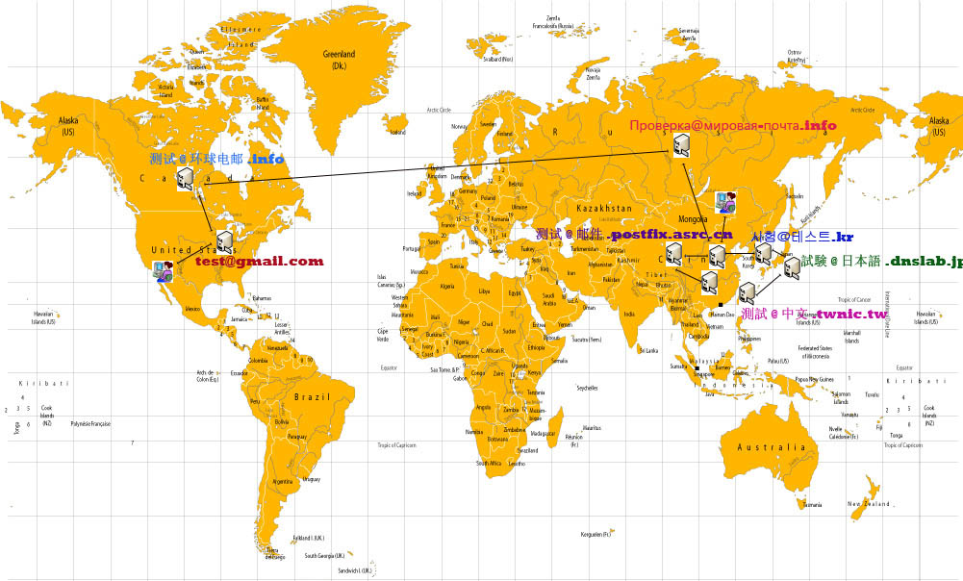
CNNIC-TWNIC-NIDA-JPRS-AFILIAS co-tests

Slide 25
In the near future, you can use these kind of email addresses.
اختبار @اختبار.eg
परीक्षा@उदाहरण.in
例え@例え.jp
실례@실례.kr
用户@中文.cn
été@Économie.fr
teuer@Schön.de

Slide 26
IETF working experiences
Join IETF mailing lists
  This is where the work happens
  Read the mails
  Give the comments
Read the drafts
Don’t be shy, Talk to people
  Exchanging ideas
  An opportunity to improve your English if you speak English as a foreign language
Look for common ground
Help people to review the drafts and issues

Slide 27
lee@cnnic.cn
李晓东@互联网中心.cn
北京市海淀区中关村南四街四号中科院软件园 邮编: 100190
www.cnnic.cn

